Slide 1
Metrological Requirements
Kevin Gudmundsson
Legal Metrology Advisor
Trading Standards
MBIE
New Zealand
Ben Aitken
Trading Standards Officer
Trading Standards
MBIE
New Zealand

Slide 2
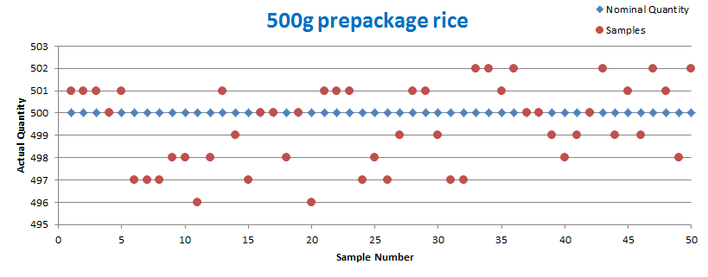
Metrological Requirements
Notes:
All packing processes fluctuate. As inspectors we want to know by how much. What is the spread and is that spread within acceptable tolerances.

Slide 3
Metrological Requirements
Determining if a lot
has passed or failed

Slide 4
Metrological Requirements
Terminology - Nominal Quantity
Quantity of product in a prepackage declared on the label by the packager
Note 1: The symbol “Qn” is used to designate the nominal quantity.

Slide 5
Metrological Requirements
Notes:
All packing processes fluctuate. As inspectors we want to know by how much. What is the spread and is that spread within acceptable tolerances.

Slide 6
Metrological Requirements
Terminology - Individual pre-package error
Difference between the actual quantity of product in a pre-package and its nominal quantity.

Slide 7
Metrological Requirements
Notes:
All packing processes fluctuate. As inspectors we want to know by how much. What is the spread and is that spread within acceptable tolerances.

Slide 8
Metrological Requirements
Terminology - Actual quantity
Amount of product that a prepackage contains as determined by measurements made by legal metrology officials.
Note: The actual quantity in a prepackage “i” is designated by the symbol Qi.

Slide 9
Metrological Requirements
Notes:
All packing processes fluctuate. As inspectors we want to know by how much. What is the spread and is that spread within acceptable tolerances.

Slide 10
Metrological Requirements
Terminology - Average error
This if the sum of individual pre-package errors, considering their arithmetic sign, divided by the number of pre-packages in the sample.
Note: The average error is designated by the symbol Eave.

Slide 11
Metrological Requirements
Notes:
All packing processes fluctuate. As inspectors we want to know by how much. What is the spread and is that spread within acceptable tolerances.

Slide 12
Metrological Requirements
Terminology - Inadequate prepackage
Pre-package with an individual pre-package error less than the nominal quantity.
Note: Also known as a non-conforming prepackage with a negative error.

Slide 13
Metrological Requirements
Notes:
All packing processes fluctuate. As inspectors we want to know by how much. What is the spread and is that spread within acceptable tolerances.

Slide 14
Metrological Requirements
Terminology - Tolerable Deficiency
The deficiency allowed in the contents of a pre-package.
The amounts are specified in Table 2
Note: The Tolerable Deficiency is designated by the symbol “T”.

Slide 15
Metrological Requirements
Table 2 - Tolerable deficiencies in actual content for prepackages
Nominal quantity of product (Qn) in g or mL | Tolerable Deficiency (T)a -------------------------- Percent of Qn | Tolerable Deficiency (T) a -------------------------- g or mL
0 to 50 | 9 | -
50 to 100 | - | 4.5
100 to 200 | 4.5 | -
200 to 300 | - | 9
300 to 500 | 3 | -
500 to 1 000 | - | 15

Slide 16
Metrological Requirements
Table 2 – cont.’
Nominal quantity of product (Qn) in g or mL | Tolerable Deficiency (T)a -------------------------- Percent of Qn | Tolerable Deficiency (T)a -------------------------- g or mL
1 000 to 10 000 | 1.5 | -
10 000 to 15 000 | - | 150
Above 15 000 | 1 | -
a T values are to be rounded up to the next 1/10 of a g or mL for Qn < 1 000 g or mL and to the next whole g or mL for Qn > 1 000 g or mL.
Notes:
a T values are to be rounded up to the next 0,1 of a g or mL for Qnom less than or equal to 1 000 g or mL and to the next whole g or mL for Qnom higher than 1 000 g or mL.

Slide 17
Metrological Requirements
Calculating the Tolerable Deficiency
Example:
Nominal quantity ‘Qn’ = 45 g -- ‘T’ = 45 x 9% = 4.1 g
Nominal quantity ‘Qn’ = 80 ml -- ‘T’ = 4.5 ml
Calculate ‘T’ for 500g Bag of rice
Nominal quantity of product (Qn) in g or mL | Tolerable Deficiency (T)a -------------------------- Percent of Qn | Tolerable Deficiency (T) a -------------------------- g or mL
0 to 50 | 9 | -
50 to 100 | - | 4.5

Slide 18
Metrological Requirements
Calculating the Tolerable Deficiency
Bag of rice = 500 g
500 g x 3% = 15 g
500 g = 15 g
T = 15 g

Slide 19
Metrological Requirements
Terminology - T1 error
A Inadequate prepackage found to contain an actual quantity of product less than the nominal quantity minus the tolerable deficiency.
Actual contents< (Q_{n} – T)
Notes:
Where the actual contents is less than the nominal quantity minus T value

Slide 20
Metrological Requirements
Terminology - T2 error
A Inadequate prepackage found to contain an actual quantity of product less than the nominal quantity minus twice the tolerable deficiency.
Actual contents < (Q_{n} – T2)
Notes:
Where the actual contents is less than the nominal quantity minus T2 value

Slide 21
Metrological Requirements
Calculating T1 & T2
T = 15 g for a 500 g bag of rice
T1 error = 15 g to 29 g
T2 error = 30 g +
Notes:
485 g – 471 g
470 g

Slide 22
Metrological Requirements
Exercise
What is ‘T1’ & ‘T2’ on a package with a nominal quantity of 275 g?
What is ‘T1’ & ‘T2’ on a package with a nominal volume of 5 L?
Notes:
1 = 9 g / 18 g
2 = 75 ml / 150 ml

Slide 23
Metrological Requirements
The Three Packers Rules

Slide 24
Metrological Requirements
Rule 1 - Average requirement
The average actual quantity of product in a pre-package in an inspection lot shall be at least equal to the nominal quantity.
The criteria shall be met if the average actual quantity of product in a pre-package in an inspection lot is estimated by sampling.

Slide 25
Metrological Requirements
Rule 1 – Calculating the average error (AE)
Calculate ‘total prepackage error’ (TPE) by adding all individual prepackage errors
Divide TPE by the ‘sample size’ to calculate (AE)
Complete this now for rice scenario
Notes:
-2 -4 -2 -4 = -12 / 4 = -3
Total Prepackage Error (TPE) -2.8

Slide 26
Metrological Requirements
Rule 1 – Calculating the average error (AE)
If AE is a positive number the inspection sample passes rule 1
If AE is a negative number calculate the ‘sample error limit’ (SEL)

Slide 27
Metrological Requirements
Rule 1 – Calculating the Sample error limit (SEL)
Compute the sample standard deviation
Compute the sample error limit by multiplying the sample standard deviation (s) with the relevant sample correction factor (SCF) from column 3 of Table 1

Slide 28
Metrological Requirements
Rule 1 – Calculating the sample error limit
SEL = Sample standard deviation (s) x SCF
Inspection lot size | Sample size (n) | Sample correction factor | Number of prepackages in a sample allowed to exceed the tolerable deficiencies in 4.2.3 (see also 2.4.1)
100 to 500 | 50 | 0.379 | 3
501 to 3 200 | 80 | 0.295 | 5
> 3 200 | 125 | 0.234 | 7
Notes:
Going back to our 500 g bag of rice scenario
Sample size 50.
Out of the 50 samples, 3 are allowed to have T1 errors.

Slide 29
Metrological Requirements
Rule 1 – Calculating the average actual quantity
Add the SEL to the AE
If the sum is positive number the sample passes
If the sum is negative number the sample fails
Complete this now for rice scenario

Slide 30
Metrological Requirements
Rule 1 – Calculating the average actual quantity
Scenario Passes Rule 1
Calculation | Result
Total Production Error (TPE) | -28
Average Error (AE) | -0.56
Sample Correction Factor (SCF) | ?
Standard Deviation (s) | ?
SEL (s x SCF) | ?
Weighted Average (SEL + AE) | ?

Slide 31
Metrological Requirements
Rule 1 – Calculating the average actual quantity
Scenario Passes Rule 1
Calculation | Result
Total Production Error (TPE) | -28
Average Error (AE) | -0.56
Sample Correction Factor (SCF) | 0.379
Standard Deviation (s) | 1.808822
SEL (s x SCF) | 0.685544
Weighted Average (SEL + AE) | 0.126

Slide 32
Metrological Requirements
Rule 2 – T1 requirement
An inspection lot shall be rejected if it contains more prepackages with a T1 error than allowed in Column 4 of table 1.

Slide 33
Metrological Requirements
Rule 2 – T1 requirement
Table 1 Sampling plans for prepackages
Inspection lot size | Sample size (n) | Sample correction factor | Number of prepackages in a sample allowed to exceed the tolerable deficiencies in 4.2.3 (see also 2.4.1)
100 to 500 | 50 | 0.379 | 3
501 to 3 200 | 80 | 0.295 | 5
> 3 200 | 125 | 0.234 | 7
Notes:
Going back to our 500 g bag of rice scenario
Sample size 50.
Out of the 50 samples, 3 are allowed to have T1 errors.

Slide 34
Metrological Requirements
Rule 3 – T2 requirement
no inadequate package should be short by T2 error or greater

Slide 35
Metrological Requirements
Complete exercise

Slide 36
Metrological Requirements
Does the 500 g bag of rice pass of fail?
Rule 1 – lot equal to or greater than Average quantity.
Rule 2 – specific number prepackages with T1 errors permitted in a lot.
Rule 3 – no prepackages with T2 errors permitted in a lot.

Slide 37
Metrological Requirements
Results of sample exercise – 500 g bag of rice
Rule 1 – lot equal to or greater than Average quantity. Pass
Rule 2 – specific number prepackages with T1 errors permitted in a lot. Pass
Rule 3 – no prepackages with T2 errors permitted in a lot. Pass

Slide 38
Metrological Requirements
The Three Packers Rules
Failure to comply with either the average or individual pre-package requirements will cause the inspection lot to be rejected.

Slide 39
Metrological Requirements
Application of the three packers rules
A prepackage shall meet the requirements of all three rules at each point of the distribution chain:
Point of pack
Import
Distribution
Wholesale
Retail

Slide 40
Statistical and general principle of control for OIML R87

Slide 41
Statistical and general principle of control
The statistical tests employed to determine if a lot is compliant are to meet four criteria’s
2 criteria’s for determining the average error
2 criteria’s for determining the individual error

Slide 42
Statistical and general principle of control
Average error
Criterion 1: The probability of rejecting a lot with average content at least equal to the nominal quantity Qn shall not exceed 0.005 (0.5%).
The test guarantees that the probability of incorrectly rejecting an inspection lot which satisfies the requirements of R87 is no more than 0.5%

Slide 43
Statistical and general principle of control
Average error
Criterion 2: The probability of rejecting a lot with standard deviation σ with average content less than Qn – 0.74σ shall be at least 0.9 (90%).
The test guarantees lots with an average actual quantity of less than Qn – 0.74σ will be correctly rejected with the probability of 90%
Notes:
0.74sigma originates from ISO 3951 – ‘sampling procedures for inspections by variables’

Slide 44
Statistical and general principle of control
Individual error
Criterion 3: The probability of rejecting a lot with 2.5% (or fewer) of individual packages having content less that Qn - T shall not exceed 0.05 (5%).
The test guarantees the probability of incorrectly rejecting an inspection lot is no more than 5%
Notes:
Rule 2
Clause 4.1.1 Less than 2.5% (1 in 40) of all pre-packages shall contain a quantity of product less than Q_{n} – T.

Slide 45
Statistical and general principle of control
Individual error
Criterion 4: The probability of rejecting a lot with 9% (or more) of individual packages having content less that Qn - T shall be at least 0.9 (90%).
The test guarantees that a lot which has 9% (or more) of the packages having a T1 error will be correctly rejected with a probability of at least 90%

Slide 46
Metrological Requirements
The Criteria shape the rules and sample sizes
Rule 1 – lot equal to or greater than Average quantity.
Rule 2 – specific number prepackages with T1 errors permitted in a lot.
Rule 3 – no prepackages with T2 errors permitted in a lot.
Notes:
The criteria’s act together to generate the sample sizes required in table 1 and the requirements of the three packers rules

Slide 47
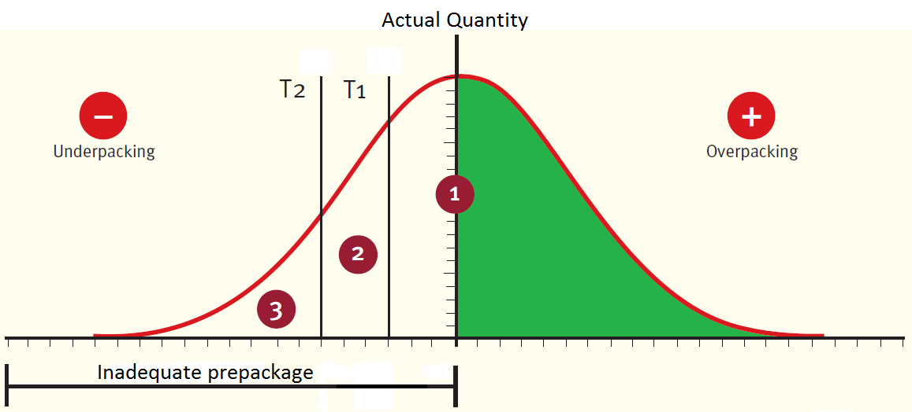
Statistical and general principle of control

Slide 48
Bag of 500g rice scenario
Analysing the results of the 500 g bag of rice average quantity inspection

Slide 49
Metrological Requirements
Notes:
All packing processes fluctuate. As inspectors we want to know by how much. What is the spread and is that spread within acceptable tolerances.

Slide 50
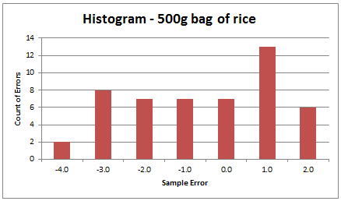
Bag of 500g rice scenario
Notes:
Frequency of each error

Slide 51
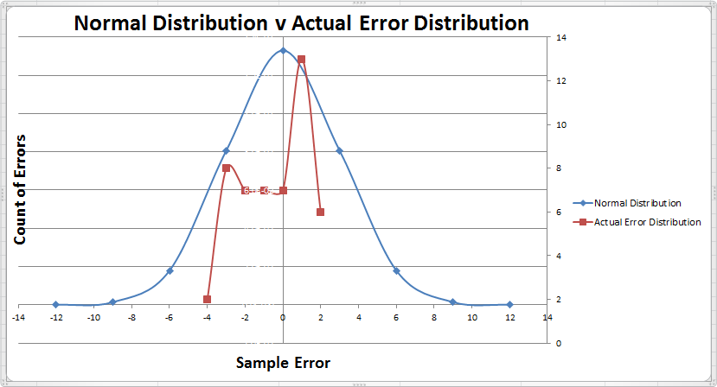
Bag of 500g rice scenario

