Slide 1
Unequal Prepackages
Ben Aitken
Trading Standards Officer
Trading Standards
MBIE
New Zealand
Kevin Gudmundsson
Legal Metrology Advisor
Trading Standards
MBIE
New Zealand

Slide 2
Unequal Prepackages
Unequal packages also known as
Catchweight
Random Nominal Quantities (RNQ)

Slide 3
Unequal Prepackages
Unequal prepackaged goods
Goods which are enclosed in a package, and
Because of their nature cannot be portioned in to a predetermined quantity, and
Are sold in varying quantities.

Slide 4
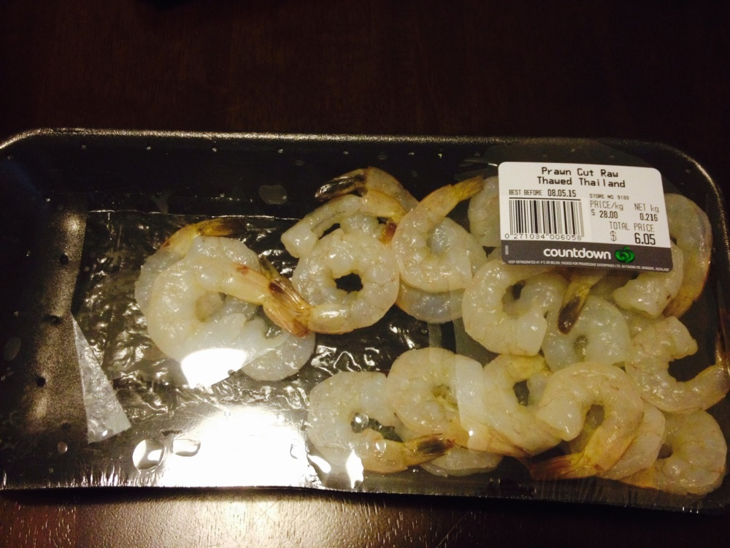
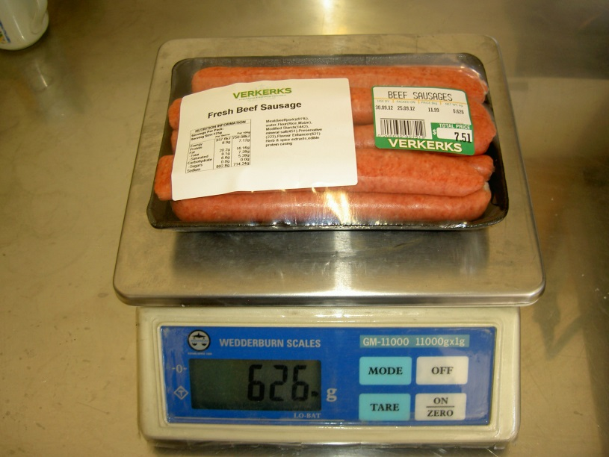
Unequal Prepackages
An example of unequal prepackaged goods is meat displayed in supermarket chillers at random weights

Slide 5
Unequal Prepackages
Unequal prepackages are not controlled by R87 or R79
Unequal prepackages may be subject to local regulations and requirements
e.g. New Zealand does not permit any deficiencies from stated quantity

Slide 6
Unequal Prepackages
Guidelines exist for negative errors for unequal packages within the ASEAN common requirements for prepackaged goods - unequal packages
There are no procedures set out for sampling any unequal prepackages found at the same time
Notes:
'Association of Southeast Asian Nations - ASEAN' An organization of countries in southeast Asia set up to promote cultural, economic and political development in the region. ASEAN was officially formed in 1967 with the signing of the Bangkok Declaration.

Slide 7
Unequal Prepackages
Because goods are all at random weights, volumes or length each package is usually assessed individually
Look for trends over all the individual prepackages
Notes:
Trends in error i.e. consistent negative error

Slide 8
Unequal Prepackages
ASEAN common requirements for prepackaged goods has a guideline for permissible negative errors
For the first step in trade unequal pre-packages with weight indication are should not have errors greater error than below
Nominal Quantity Q_{n} in g | Permissible negative error in g
Up to 500 | 2.0
501 to 2000 | 5.0
2001 to 10000 | 10.0

Slide 9
Unequal Prepackages
Inspections are often carried out at retail premises and each prepackage is assessed individually
There are no procedures set out for sampling any number of unequal packages found at the same time
Inspections may be
Informal in nature, or
Formal in nature

Slide 10
Unequal Prepackages
When a number of unequal packages are inspected at the same time and place it is appropriate to look at the trend over all the unequal packages of a particular category
Inspections may be
Informal in nature, or
Formal in nature

Slide 11
Unequal Prepackages
Informal Inspection
An informal inspection may be carried out during routine marketplace surveillance
Carried out on a broad category of unequal prepackages i.e. meat
Notes:
Informal inspections are not usually instigated as a result of a consumer complaint and are simply used to give the LMO and their local authority confidence that complinace is being maintained by the trader

Slide 12
Unequal Prepackages
Informal Inspection
Randomly select a number of prepackages of a broad category such as meat packs, vegetable packs or fruit packs
Select goods packed in the same style and size
Notes:
Clarify – Formal and Informal

Slide 13
Unequal Prepackages
Informal inspection - Guidelines for sample size
No. of Pre-packages Available for Inspection (same kind) | No. of Pre-packages to be selected
12 or less | 4
13 to 99 | 6
100 to 500 | 12
500 to 3200 | 24
> 3200 | 36

Slide 14
Unequal Prepackages
Informal Inspection
Weigh or measure the prepackages selected, deducting the tare weight where goods are marked with a net weight
Notes:
No need to use ATW
Ensure your tare value is complete and accurately represents the prepackages you are inspecting

Slide 15
Unequal Prepackages
Formal Inspection
An Formal inspection should be carried out as a result of finding non-compliance during an informal inspection
Formal inspections of unequal prepackages are carried out on a specific category of unequal prepackages i.e. prawns
Notes:
Informal inspections are not usually instigated as a result of a consumer complaint and are simply used to give the LMO and their local authority confidence that complinace is being maintained by the trader

Slide 16
Unequal Prepackages
Formal Inspection
Randomly select a number of prepackages of a broad or more specific category of prepackages i.e. prawns, steak or lamb
Notes:
Formal

Slide 17
Unequal Prepackages
Formal inspection - Guidelines for sample size
No. of Pre-packages Available for Inspection (same kind) | No. of Pre-packages to be selected
2 to 12 | All
13 to 99 | 12
100 to 500 | 50
500 to 3200 | 80
> 3200 | 125

Slide 18
Unequal Prepackages
Formal Inspection
Weigh or measure the prepackages selected, deducting the tare weight where goods are marked with a net weight
Notes:
No need to use ATW
Ensure your tare value is complete and accurately represents the prepackages you are inspecting

Slide 19
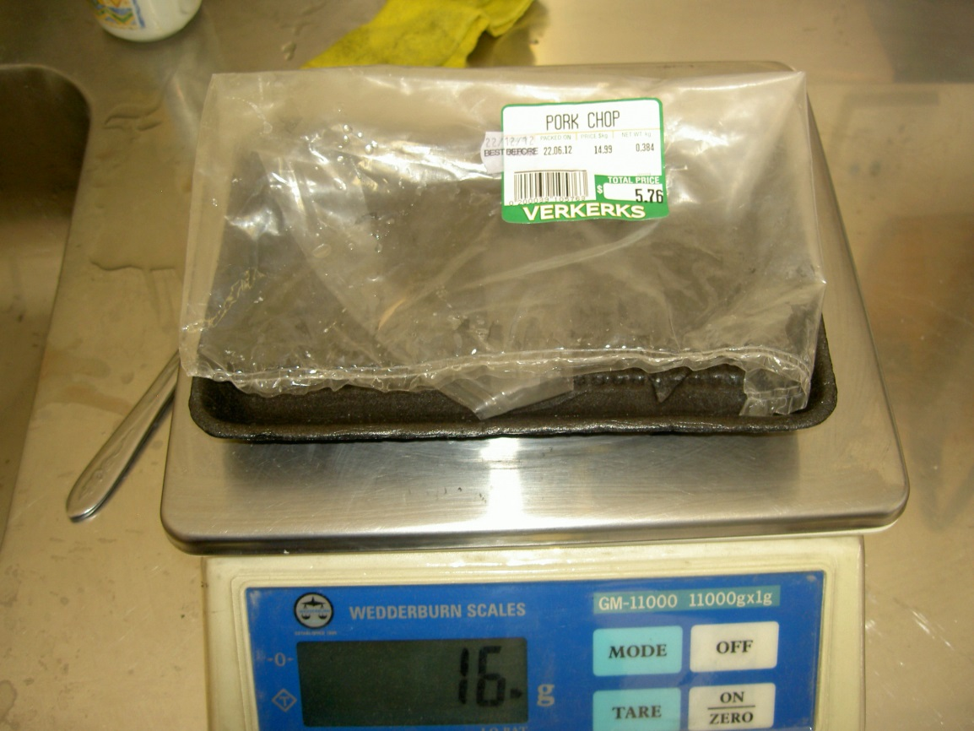
Unequal Prepackages
Determine the tare weight of the prepackage
Take care to ensure an accurate and representative tare weight is obtained
Notes:
Clean unused tare preferable – Ask the retailer to make up a dummy package

Slide 20
Unequal Prepackages
Weigh or measure the prepackages and deduct the tare weight
Calculate the Actual net contents and determine the error by deducting the stated net quantity
Gross Weight – Tare = Net
Net – Stated Quantity = Error

Slide 21
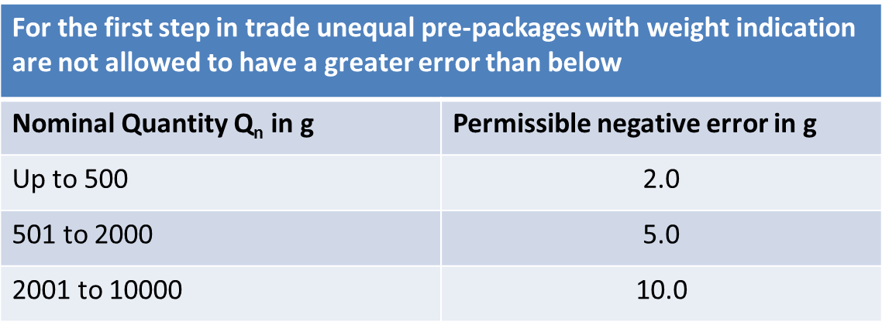
Unequal Prepackages
Apply the guidelines from the table below or your economies law regarding unequal packages
Notes:
A negligible deficiency

Slide 22
Unequal Prepackages
Where there are negligible deficiencies on only some of the prepackages
A negligible deficiency is one where the deficiency is
≤ the permissible negative error (g)
Consider if it is appropriate to discount the deficiencies

Slide 23
Unequal Prepackages
Where there are deficiencies on all the prepackages
Check the equipment the trader has used to weigh the goods on for error to determine is this the cause of the deficiencies
Notes:
Use verified test masses and apply NAWI test procedures

Slide 24
Unequal Prepackages
Where there are negligible deficiencies on all the prepackages and the error is not caused by an error in the weighing instrument then:
Educate the trader
Schedule follow up inspections
Consider an oral warning
Consider a written warning
Notes:
Re-package – re-label all effected prepackages
Interview the trader to determine their knowledge of the incident

Slide 25
Unequal Prepackages
Where there are deficiencies on all the prepackages and the error is considerable i.e. greater than the permissible negative error allowed;
Educate the trader
Schedule follow up inspections
Issue an oral warning
Issue a written warning
Consider Prosecuting the trader
Notes:
Re-package – re-label all effected prepackages
Interview the trader to determine their knowledge of the incident
Determine how widespread the prepackages are

Slide 26
Unequal Prepackages
Thank you for your attention
Any Questions?

