Slide 1
PRE-PACKAGED PRODUCTS
NON-COMPLYING GOODS
Ben Aitken
Trading Standards Officer
Trading Standards
MBIE
New Zealand
Kevin Gudmundsson
Legal Metrology Advisor
Trading Standards
MBIE
New Zealand

Slide 2
Non-Complying Goods
What to do about non-complying pre-packages
Non-compliance may be in relation to;
Labelling of goods (R79), or
Short weight, measure or number (R87), or
Both labelling & short quantity

Slide 3
Non-Complying Goods
What to do about non-complying packages:
Note: Precedence should be given to your economies legislation regarding pre-packaged goods offences

Slide 4
Non-Complying Goods
What to do about incorrectly labelled pre-packages:
Where packages have been labelled incorrectly;
Identify and isolate the affected batch
Re-package or re-label the affected pre-packages
Notes:
Repackaging may not always be an option

Slide 5
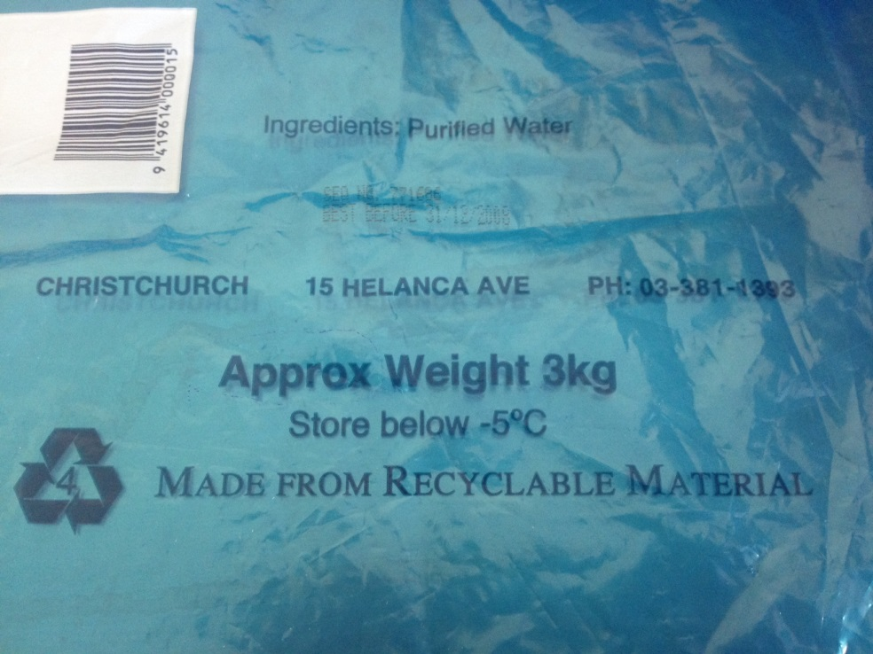
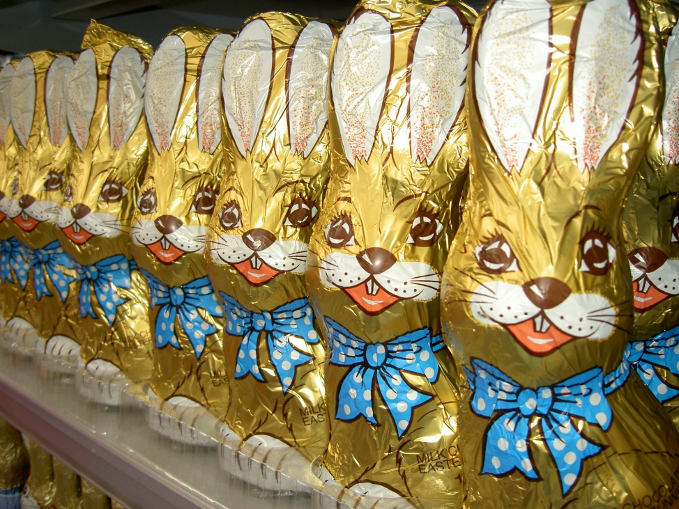
Non-Complying Goods
What to do about incorrectly labelled packages:

Slide 6
Non-Complying Goods
What to do about short quantity pre-packages
The manufacturer / packer should;
Identify the affected goods
Take action to quarantine the goods
Investigate to determine the cause of the errors
Rectify the problem
Ensure pre-packaged goods meet the requirements of AQS

Slide 7
Non-Complying Goods
What to do about short quantity packages
Identify the Causes and Solutions;
Unsuitable Equipment
Operator Behaviour

Slide 8
Non-Complying Goods
Causes of non-complying goods
Unsuitable Equipment
Accurate?
Being used correctly?
Division size appropriate?
Environmental disturbances?

Slide 9
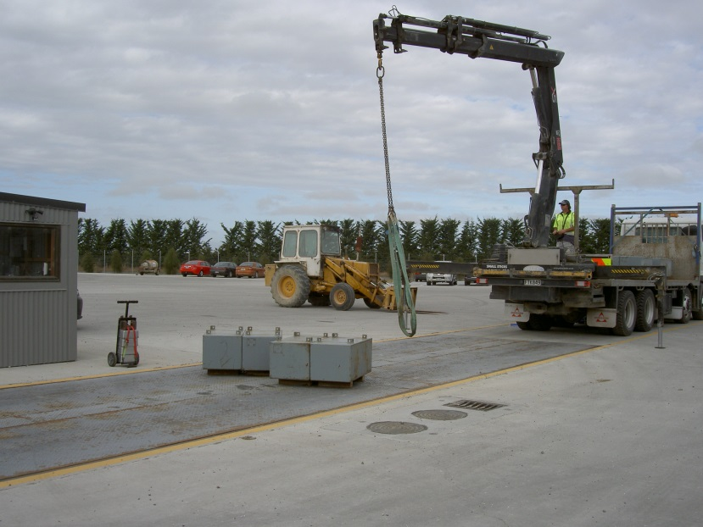
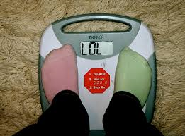
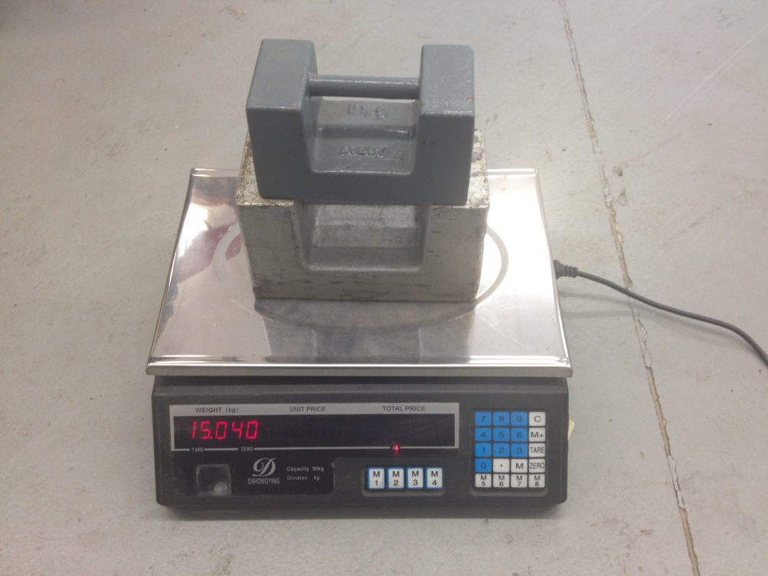
Non-Complying Goods
Causes of non-complying goods
Unsuitable Equipment?

Slide 10
Non-Complying Goods
Causes of non-complying goods
Suitable Equipment Guidelines
Notes:
Guidelines can be used

Slide 11
Non-Complying Goods
Causes of non-complying goods
Operator Behaviour;
Insufficient training or understanding
Equipment
Procedure
Legislative requirements
Inadequate / insufficient oversight
Business owner
Regulatory presence

Slide 12
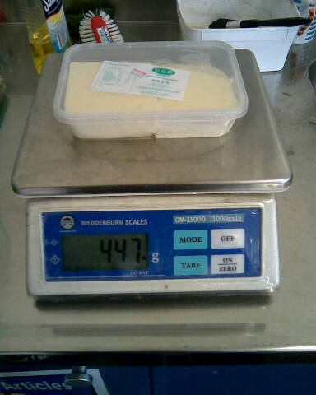
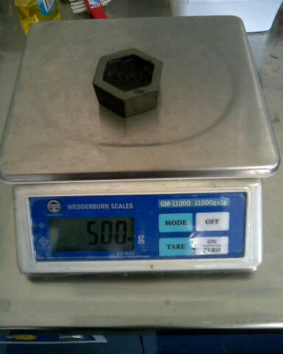
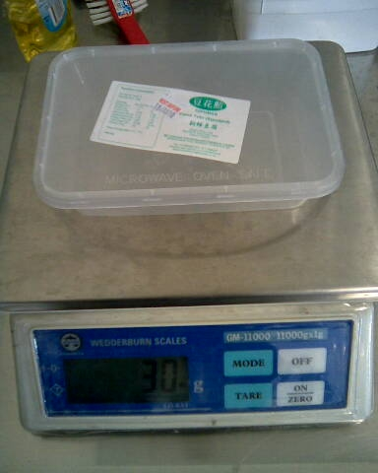
Non-Complying Goods
Causes of non-complying goods
Operator Behaviour
600g Stated Net???

Slide 13
Non-Complying Goods
What to do about short quantity packages
Sorting Quarantined Packages
Identifying and isolating an affected batch
Removing excessively deficient packages
Re-checking a sample

Slide 14
Non-Complying Goods
What to do about short quantity packages
Re-labelling the pre-packages with the correct weight
This may be most appropriate for importers or a suitable solution for pre-packages already distributed into the marketplace

Slide 15
Non-Complying Goods
What to do about short quantity packages
Re-packing or topping up
Deficient pre-packages can be re-packaged or topped up
A sample of the altered batch should be checked to ensure it meets all the requirements

Slide 16
Non-Complying Goods
What to do about short quantity packages
If the investigation into the short quantity packages goods has identified that short quantity pre-packages are already in the marketplace then the manufacturer or packer needs to contact their customers and advise them to check their stock
Notes:
Contact LMO in manufacturers country

Slide 17
Non-Complying Goods
Resources
It is often useful to develop your own
Factsheets
Websites, or
Resources
to give to a manufacturer or packer

Slide 18
Non-Complying Goods
Thank you for your attention
Any Questions?

