Slide 1
Test Procedures for Determining the Actual Quantity of Frozen Foods
Kevin Gudmundsson
Legal Metrology Advisor
Trading Standards
MBIE
New Zealand
Ben Aitken
Trading Standards Officer
Trading Standards
MBIE
New Zealand

Slide 2
Test Procedures for determining the actual quantity of frozen products
OIML R87 Annex D
This annex gives guidelines for testing three different types of frozen products.
Frozen fruits and vegetables
Glazed seafood
Frozen shrimp and crab meat

Slide 3
Test Procedures for determining the actual quantity of frozen products
OIML R87 Annex D
All methods involve destructively testing each product.
This means that the product can not be resold following testing.

Slide 4
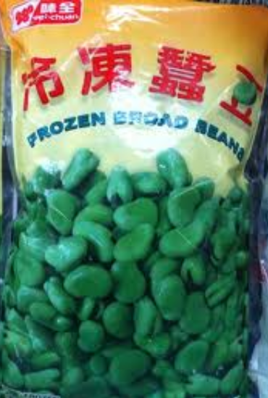
Frozen fruits and vegetables

Slide 5
Frozen fruits and vegetables
Equipment used to determine the actual quantity:
Suitable weighing instrument and test weights.
Thermometer with 1 °C graduations and accurate to ± 1 °C.
Water source and hose.
Sink or other receptacle.

Slide 6
Frozen fruits and vegetables
Sieve
20 cm diameter with 2.36 mm square openings.
for pre-packages with a nominal quantity up to 1.4 kg.
30 cm sieve with 2.36 mm square openings.
for pre-packages greater than 1.4 kg.
A drip pan.
Stop watch.

Slide 7
Frozen fruits and vegetables
Procedure
Select sample in the normal manner.
Weigh sieve and drip pan together and record weight. (mt)
Determine the gross weight of each individual
pre-package.

Slide 8
Frozen fruits and vegetables
Immerse the pre-package in water maintained at 20 °C (± 1 °C) with a continuous flow.
If the pre-package is not water-tight, place it in a plastic bag and remove any excess air using a vacuum and then seal it securely.
Avoid agitating the pre-package while it is thawing.

Slide 9
Frozen fruits and vegetables
When all of the ice has melted, remove pre-package from the water bath and wipe it dry.
Open the pre-package with care and a minimum of agitation.
Tilt sieve approximately 17° to 20° from the horizontal to facilitate drainage.
Distribute the product evenly over the sieve in one sweeping motion.
Drain for 2 minutes

Slide 10
Frozen fruits and vegetables
Transfer the sieve containing the product to the drip-pan
Weigh sieve and drip pan (m_{d}) and deduct weight obtained in step 2 to determine the actual drained quantity of the product.
Actual drained contents = m_{d} – m_{t}
M_{d} = Sieve and drip plan plus product
M_{t} = Sieve and drip plan no product

Slide 11
Frozen fruits and vegetables
12. Repeat steps 2 to 11 for each pre-package.

Slide 12
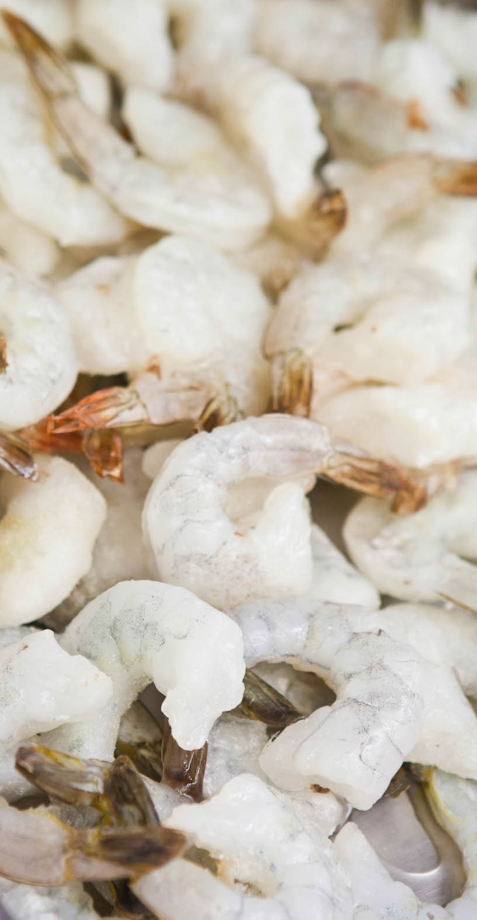
Glazed Seafood

Slide 13
Glazed Seafood
Glazed seafood
Seafood that is covered with a film of water and then frozen to preserve its quality.
The actual quantity of the seafood shall be exclusive of the glaze.
Notes:
Glazing is the term used to describe the application of a protective coating of ice (ice glaze) to frozen seafood products. The ice layer excludes air from the surface of the product, reducing the rate of oxidation.
By definition a package includes anything in or by which goods are cased, covered, contained, or packed. In general terms the glaze is considered to be part of the packaging material and therefore must be excluded from the net contents.

Slide 14
Glazed Seafood
Equipment required to determine actual quantity
Suitable weighing instrument and test weights.
Water source, hose and spray head.
Sink or other receptacle.

Slide 15
Glazed Seafood
Sieve
20 cm diameter with 2.36 mm square openings.
for pre-packages with a nominal quantity 900 g or less.
30 cm diameter sieve with 2.36 mm square openings.
for pre-packages greater than 900 g.
Wedge to provide tilt to 17˚ to 20˚ from the horizontal
A container large enough to hold the product.
Stop watch.

Slide 16
Glazed Seafood
Inspection Procedure
Select sample in the normal manner.

Slide 17
Glazed Seafood

Slide 18
Glazed Seafood

Slide 19
Glazed Seafood
Repeat steps 1 to 6 for each pre-package.

Slide 20
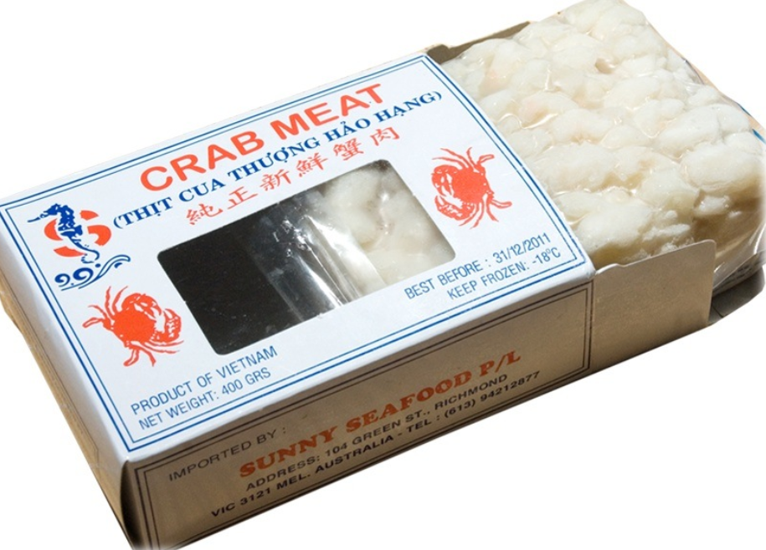
Frozen shrimp and crabmeat

Slide 21
Frozen shrimp and crabmeat
Test equipment required to determine the net weight of frozen shrimp and crabmeat.
Suitable weighing instrument and test weights.
Thermometer with 1 °C graduations and accurate to ± 1 °C.
Water source and hose with a 4 L to 11 L per minute flow rate
Sink or other receptacle (e.g. 15 litre container).
Notes:
How to test flow rate? Get a receptacle that can hold 10 L. fill bucket and adjust flow so that it is within 4-11 Litres for 60sec of flow

Slide 22
Frozen shrimp and crabmeat
A wire mesh basket or other container that is large enough to hold the contents of 1 package and has openings small enough to retain all pieces of the product.

Slide 23
Frozen shrimp and crabmeat
Sieve
20 cm diameter with 2.36 mm square openings.
for pre-packages with a nominal quantity up to 450 g.
30 cm diameter sieve with 2.36 mm square openings.
for pre-packages greater than 450 g.
A container large enough to hold the product
Stopwatch

Slide 24
Frozen shrimp and crabmeat
Procedure
Select sample in the normal manner.
Weigh a container large enough to hold the product and record the result. (M_{t})
Determine the weight of each individual
pre-package.

Slide 25
Frozen shrimp and crabmeat
Unwrap the frozen shrimp or crabmeat and place it in the wire mesh basket.
Immerse basket and product in a 15 L or larger container of fresh water at a temperature
of 26 °C (± 1 °C)
Submerge the basket so that the top of the basket extends above the water level

Slide 26
Frozen shrimp and crabmeat
Maintain a continuous flow of water into the bottom of the container to keep the temperature within the specified range.
As soon as the product thaws, determined by loss of rigidity, transfer all material to a sieve.
Without shifting the product on the sieve, incline the sieve approximately 30° from the horizontal position to facilitate drainage.
Drain for 2 min.

Slide 27
Frozen shrimp and crabmeat
At the end of the drain time, immediately transfer the product to the pre-weighed container
Weigh product and container together and record result. (m_{d})
Deduct weight of pre-weighed container from product and container weight to determine the actual drained quantity of the product.
Actual drained contents = m_{d} – m_{t}
M_{d} = Sieve and drip plan plus product
M_{t} = Sieve and drip plan no product

Slide 28
Frozen shrimp and crabmeat
13. Repeat steps 2 to 12 for each pre-package.

