Slide 1
Promoting Legal Metrology to the Public in Indonesia
Presented by: Dr. Rifan ARDIANTO

Slide 2
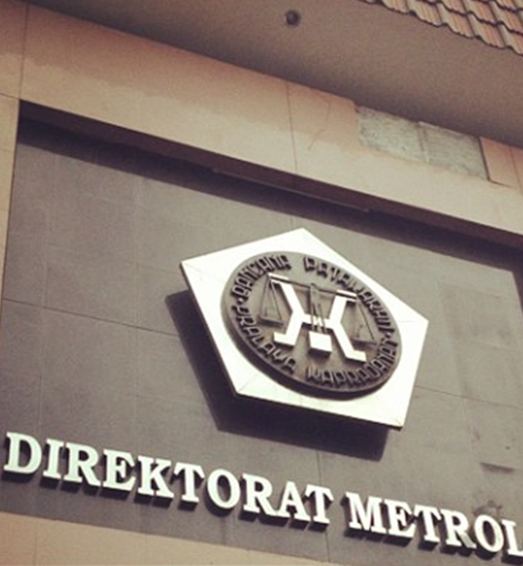
INTRODUCTION
Directorate of Metrology is a government institution which has responsibility in legal metrology activities in Indonesia.
Its structure is under the Directorate General of Consumer Protection and Trade Compliance, Ministry of Trade of the Republic of Indonesia.
26th APLMF
Ha Long City, Viet Nam
6-8 November 2019

Slide 3
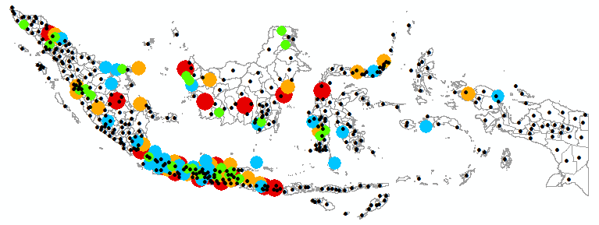
ORGANIZATIONS
Since 2014, regarding to Act No. 23/2014 on Local Government, legal metrology activities are done by local government at regency/city level.
The changing legal metrological structure has impacted to the establishment of local verification offices (LVO) at regency/city, which has a total 508 regencies/cities.
Currently, there are 255 local governments who has established local verification office and has performed verification activities.
The rest will be operated in 2020.
26th APLMF
Ha Long City, Viet Nam
6-8 November 2019

Slide 4
CHALLENGES
26th APLMF
Ha Long City, Viet Nam
6-8 November 2019

Slide 5
Consumer Index of Indonesia
Capable, is able to use their rights and responsibilities to decide the needs in their best
Understand, is knowing their rights and responsibilities to protect them self
26th APLMF
Ha Long City, Viet Nam
6-8 November 2019

Slide 6
Paradigm: beyond technology
Traditional approach
New approach
To Promote and Protect Consumers
The traditional focus of legal metrology authorities has been based on the ability to provide an efficient service to ensure fair trade in measurement.
The focus of the activities has been on the verification and inspection of measuring instruments
Promoting ‘smart-behavior’ to and for consumers
Protecting consumers from deceptive and fraudulent practices.
Promoting ‘Smart-Behaviour’ Consumers : 70%
Protecting Consumers : 30%
Consequences is to focus on technological solutions
more difficult to achieve because of the long time span and the relatively high cost
26th APLMF
Ha Long City, Viet Nam
6-8 November 2019

Slide 7
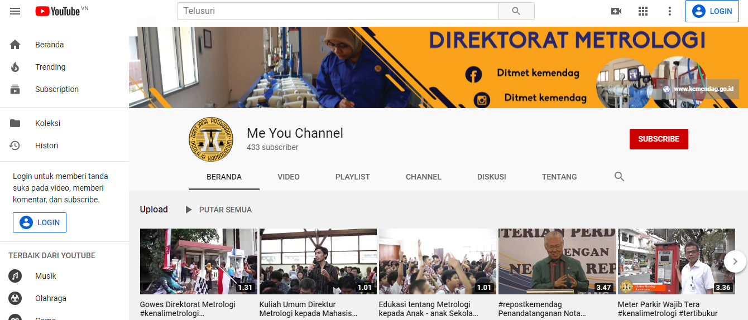
What we have done
Promoting metrology in Social Media
Create Metrology Youtube channel
Post activities in Instagram, Facebook, etc
Videos on how to repair NAWI
Videos on how to check NAWI in practice
Videos about metrology
Videos about the activities of Directorate of Metrology
Direktorat Metrologi
Ditmet Kemendag
Ditmet Kemendag
Ditmet Kemendag
26th APLMF
Ha Long City, Viet Nam
6-8 November 2019

Slide 8
What we have done
Activation of community
Bike Community – where a distance is well-measured
Outdoor events (Fun walk)
Goes to schools
Break-through events
Metrology in a cup of coffee
Metrology and halal industry
This objective of promoting metrology will be achieved throughout an impact on participants directly and on others by word of mouth, publicity around the events, establishing social networks, etc
26th APLMF
Ha Long City, Viet Nam
7-9 November 2019

Slide 9
What we have done
Activation of community
Bike Community – where a distance is well-measured
Outdoor events (Fun walk)
Goes to schools
Break-through events
Metrology in a cup of coffee
Metrology and halal industry
This objective of promoting metrology will be achieved throughout an impact on participants directly and on others by word of mouth, publicity around the events, establishing social networks, etc
26th APLMF
Ha Long City, Viet Nam
7-9 November 2019

Slide 10
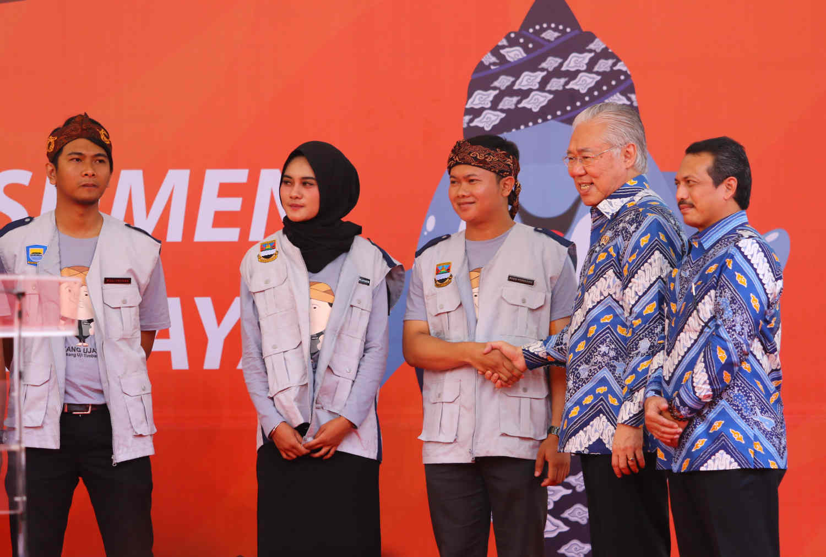
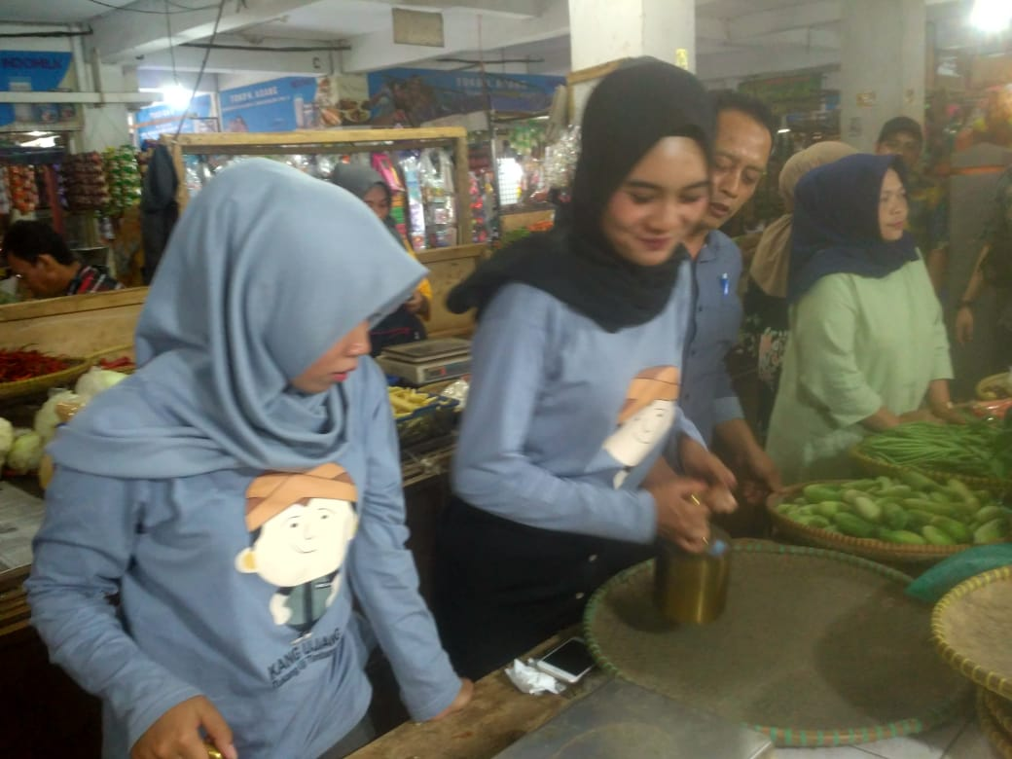
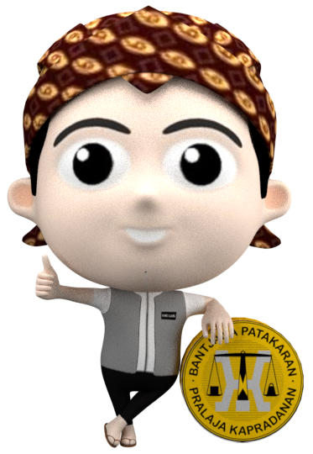
What we have done
Create a certified measurer at traditional market
Community involvement
is a collaborative activity between legal metrology institutions and community (e.g. traditional market management)
to help inspector in checking the weighing scale used at traditional market, and in educating trader and consumer
Outcome: creating value for better metrological practice and to reach the purpose in ensuring the measuring instruments used for trade and giving consumer protections.
26th APLMF
Ha Long City, Viet Nam
6-8 November 2019

Slide 11
26th APLMF
Ha Long City, Viet Nam
7-9 November 2019

Slide 12
What we will do next ….
Indonesia will organize a high-profile event “Metrology beyond Technology – Pathways to impact” in 2020
Collaboration with ASEAN Member State and PTB
The basic objectives of the event is to increase the awareness of stakeholders about the important of metrology and the branding of the role of the metrology in delivering consumer protection and confidence.
The International/Regional Legal Metrology Conference
Bringing together researchers, practitioners, and policy-makers to discuss issues, tackle challenges, develop professionally, share opinions, find solutions and explore opportunities in the areas of metrology (with balance between legal metrology, scientific metrology, and industrial metrology).
The running event (Outdoor activities)
To turn this into a running event where runners are not just participating for themselves but for educated them with metrology issues through such as message and metrological symbols in their t-shirt, medals, banners, posters, and other medias.
Bringing the theme “Run Metrology in Color” into something even greater and reaches out of people at national and ASEAN region who would care and aware with metrology in their daily life.
26th APLMF
Ha Long City, Viet Nam
6-8 November 2019

Slide 13
THANK YOU

