Slide 1
PRE-PACKAGED PRODUCTS EQUIPMENT & TRACEABILITY
Ben Aitken
Trading Standards Officer
Trading Standards
MBIE
New Zealand
Kevin Gudmundsson
Legal Metrology Advisor
Trading Standards
MBIE
New Zealand

Slide 2
Equipment
Average Quantity System inspections may require a variety of often specialised equipment to carry out efficiently and effectively
Remember the 5 P’s
Prior Planning Prevents Poor Performance
Notes:
2

Slide 3
Equipment
Pre-inspection
Contact the manufacturer / packer and advise notify them of your intentions
Ask a few questions to determine what equipment is required
Notes:
Be clear about what you want to inspect, when you want to do it and why you are doing it.
These conversations may often start with some background on AQS and what it is.
3

Slide 4
Equipment
Pre-inspection
Determine if there are any site specific health and safety requirements
Personal Protective Equipment (PPE)
Hygiene requirements - equipment
Site inductions
Permits for work
Notes:
Determine what specialist Personal Protective Equipment (PPE) you may require while on site
-Safety Glasses, Boots, High Viz clothing, Ear protection, Hard Hats etc.
Determine if there are any Health & Safety inductions you require
Permits- Hot work, working at heights
4

Slide 5
Equipment
When contacting the manufacturer
Introduce yourself
Be clear about what it is you want / require
Explain the purpose of your visit
You will most likely be causing some disruption therefore it is important the company understands what is to happen
Notes:
Explain Professional conduct
Courteous behaviour
Introduction
Be professional
Advise the manufacturer or packer that you may require assistance
5

Slide 6
Equipment
Pre-inspection
Determine the method of production and packaging
Package nominal quantity
Production times
Maximum hourly output of production line
Notes:
Make contact with the manufacturer and advise them of your intentions and ay background information i.e. to carry out an AQS as a result of marketplace surveillance or a consumer complaint.
Ask questions regarding;
-production methods
-historical density (or specific gravity) figures
-when they are next packaging the product in question
-special requirements
-location of production facility
-arrange a time and place to meet the product
6

Slide 7
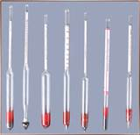
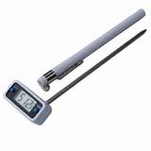
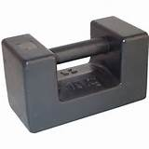
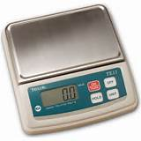
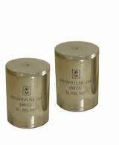
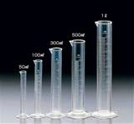
Equipment
Notes:
7

Slide 8
Other Relevant Items
Identification
Reference Material
R87
Advice documents for trader
Random number tables
Laptop / Tablet

Slide 9
Equipment
Your equipment
Make sure the weighing / measuring equipment you take with you is;
Suitable for the type of goods you are inspecting,
and
Suitably accurate
Notes:
9

Slide 10
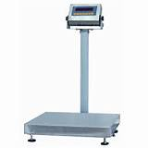
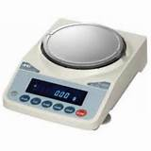
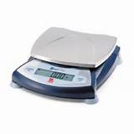
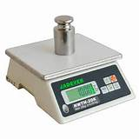
Equipment
What is a suitable weighing instrument
Notes:
Suitability of equipment is important but accuracy will often take precedence.
The manufacturer or packer may have equipment on site which is appropriate for the task.
10

Slide 11
Equipment
Suitable Weighing Instrument
Guidelines on scale interval size
Gross Weight (g) of Pre-package | Scale interval (d) in g
<25 | 0.01
≥25 to <1000 | 0.1
≥1000 to <5000 | 1.0
≥5000 | 2.0
Notes:
Suitability of equipment is important but accuracy will often take precedence.
The manufacturer or packer may have equipment on site which is appropriate for the task.

Slide 12
Equipment
Setting up equipment on site
Find a suitable location to set up your equipment
Convenient to inspection lot / production line
Safe, away from moving vehicles etc
A good working height
On a stable, level surface
Plenty of room for stacking packages
Dry, with minimal environmental disturbances
Notes:
Take a bit of time to ensure the test environment is going to be suitable for the duration of the test. You don’t want to introduce any unnecessary errors and you may be there for a while.
Take note of;
-Hazards
-Noise
-Vehicle movements
-Machinery (Viration)
-Draughts, wind & rain
12

Slide 13
Equipment
Setting up equipment on site
Test your weighing equipment on site prior to undertaking any weighing to determine its suitability.
If errors are found in your weighing equipment, note the errors and determine if the equipment is till suitable
Notes:
Consider taking a photo of the equipment with test masses on it for evidential purposes
13

Slide 14
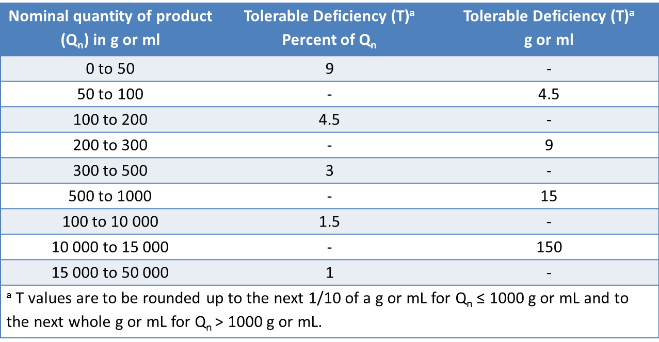
Equipment
Weighing Instrument
In general a weighing instrument is considered appropriate if it is verified and the maximum permissible error in service is no more than 0.2 T of the pre-package to be tested.
Table 2 (R87) - determine the amount of error allowed (T)
Notes:
Hands up, who knows what a NAWI is?
Who knows how to test a NAWI?

Slide 15
Equipment
Weighing Instrument
e.g. nominal content of the pre-package: = 500 g
T = 15 g
The instrument shall have an error no greater than 15 g x 0.2
15 g x 0.2 = 3 g

Slide 16
Equipment
Uncertainty Budget
The expanded uncertainty (at the k= 2 level of confidence) associated with measuring instruments and test methods shall not exceed 0.2xT
LM officials may permit deviations in the quantity of product (i.e. hygroscopic products –attract and hold water molecules from the environment –fertilizers, soap flakes, yeast) caused by ordinary and customary exposure to environmental conditions
Notes:
Any tests used by LM officials for acceptance or rejection of inspection lots shall take these parameters into consideration
▪Significance levels of the tests for Type I and Type II risks are also set
- Increased confidence in inspection results when measuring only a sample of the population
- Sample correction factors are given to reduce the probability of incorrectly rejecting a batch that is correctly filled on average to 0,5% or less (Table 1, column 3)
- Number of packages allowed to have T1 errors increased to reduce the probability of incorrectly rejecting a correct batch containing not more than 2.5% packages with T1 errors, to 5% or less (Table 1, column 4)
16

Slide 17
Equipment
Suitable Weighing Equipment
Notes:
17

Slide 18
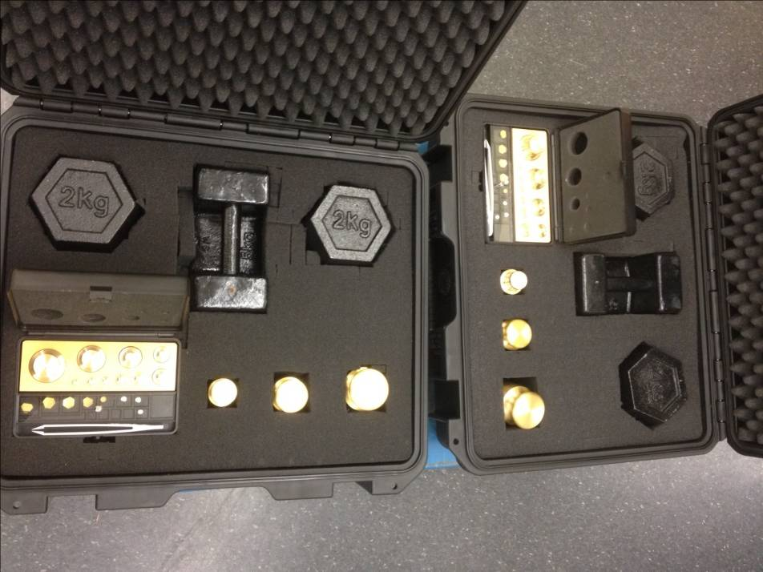
Equipment
Masses
To verify the accuracy of the weighing instrument
Appropriate class (M1 or better)
Suitably accurate
Traceable
Notes:
Caution may need to be taken regarding hygiene requirements of weights taken into food production facilities, you may be required to use stainless steel weights and weights may need to be cleaned beforehand

Slide 19
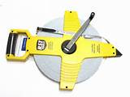
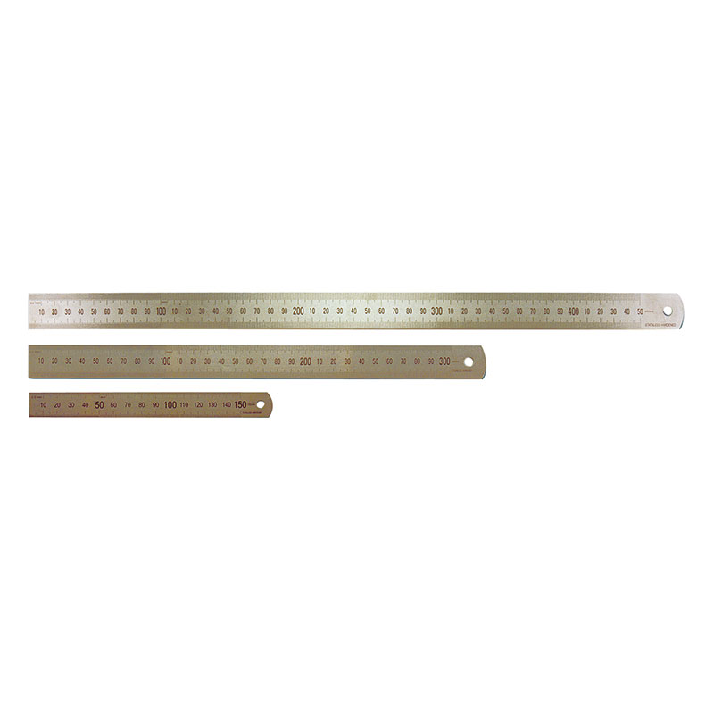
Equipment
Equipment
Length measures
Tape Measure
Rigid length measure
Notes:
Used to determine the errors on goods sold by length or area
19

Slide 20
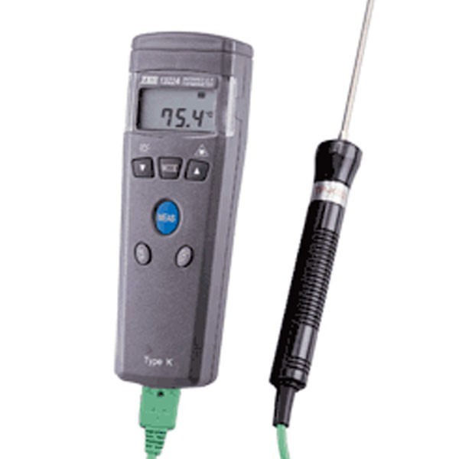
Equipment
Equipment
Thermometer
Measuring temperature of
air or liquid
Ideally resolution of 0.1 C
and traceable
Notes:
20

Slide 21
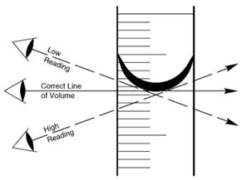
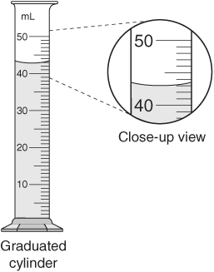
Equipment
Equipment
Graduated cylinder
Notes:
Be careful not to introduce parallax error. Always ensure that readings are taken with the vessel at eye level, in the same plane of sight.
Readings should always be taken from the bottom of the meniscus.
21

Slide 22
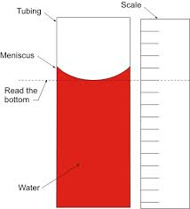
Equipment
Equipment
Reading a meniscus
A meniscus is the curved surface at the top of a column of liquid.
The volume should be read from the bottom of the meniscus.
Notes:
Kevin to discuss in more detail in the Volume determination section
22

Slide 23
Equipment
Equipment
Hydrometer
The function of the hydrometer is based on Archimedes principle that a body suspended in a liquid will be buoyed up by a force equal to the weight of the liquid displaced. Thus, the lower the density of the substance, the lower the hydrometer will sink.
Notes:
Be careful not to introduce parallax error. Always ensure that readings are taken with the vessel at eye level, in the same plane of sight.
Readings should always be taken from the bottom of the meniscus.
Kevin to discuss in more detail in the Volume determination section
23

Slide 24
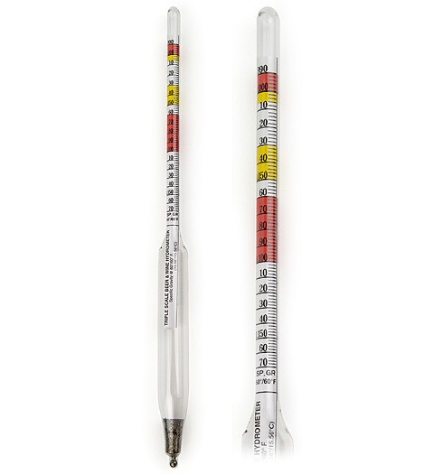
Equipment
Equipment
Hydrometer
Used by filling a cylinder with enough product to allow the hydrometer to float.
Carefully lower the hydrometer into the cylinder and gently spin while releasing
Notes:
Kevin to discuss in more detail in the Volume determination section
24

Slide 25
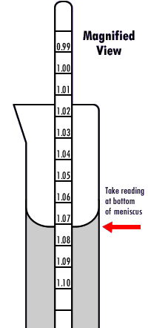
Equipment
Equipment
Hydrometer
When reading the density from a hydrometer always take the reading at the bottom of the meniscus
Notes:
Be careful to minimise the chance of introducing parallax error. Ensure readings are taken with the cylinder at eye level
25

Slide 26
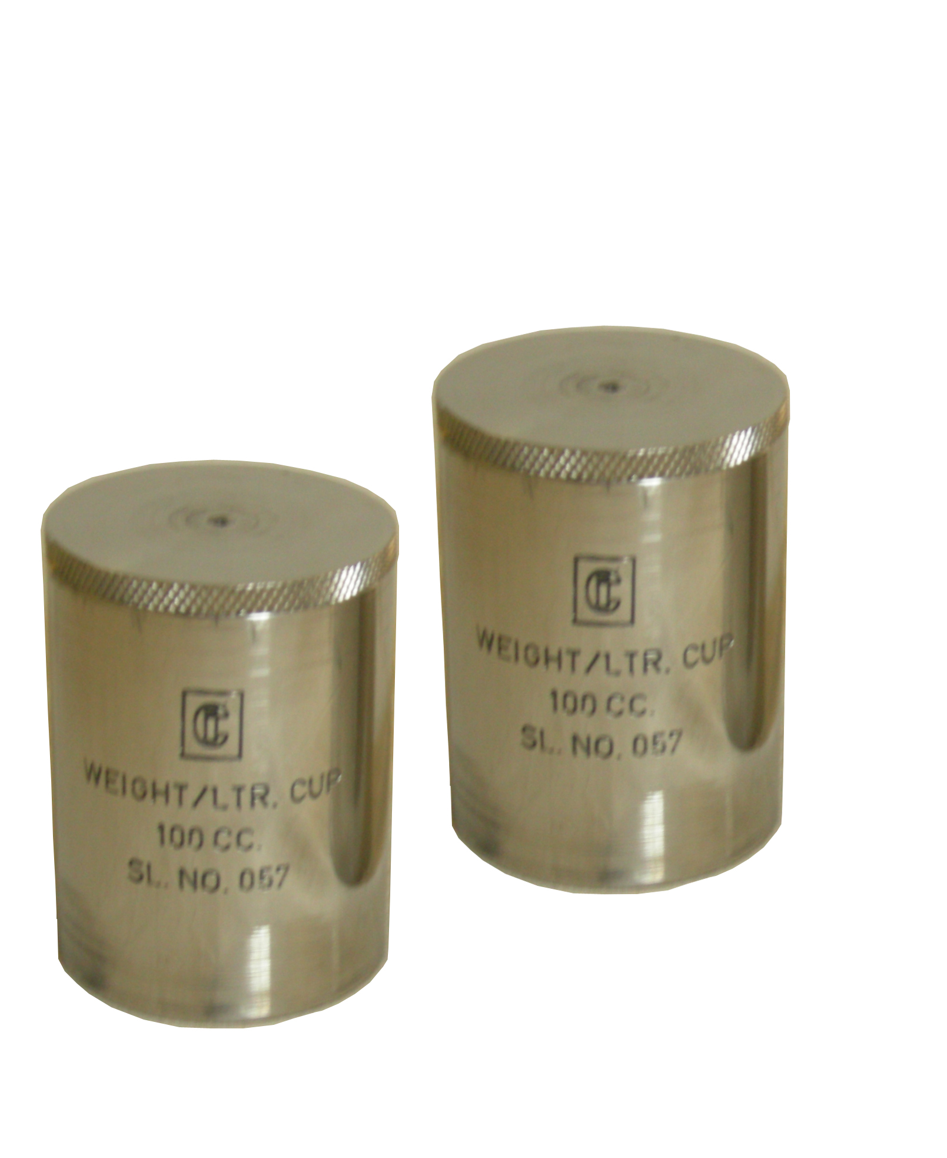
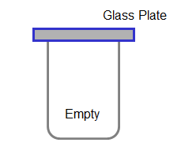
Equipment
Equipment
Density Cup
Used for determining the density of a liquid
Used with a weighing instrument and traceable masses
Notes:
26

Slide 27
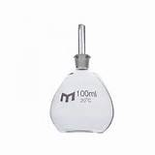
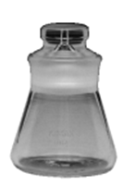
Equipment
Equipment
Glass Pycnometer
Used for determining density of a liquid
Used with a weighing instrument
Notes:
27

Slide 28
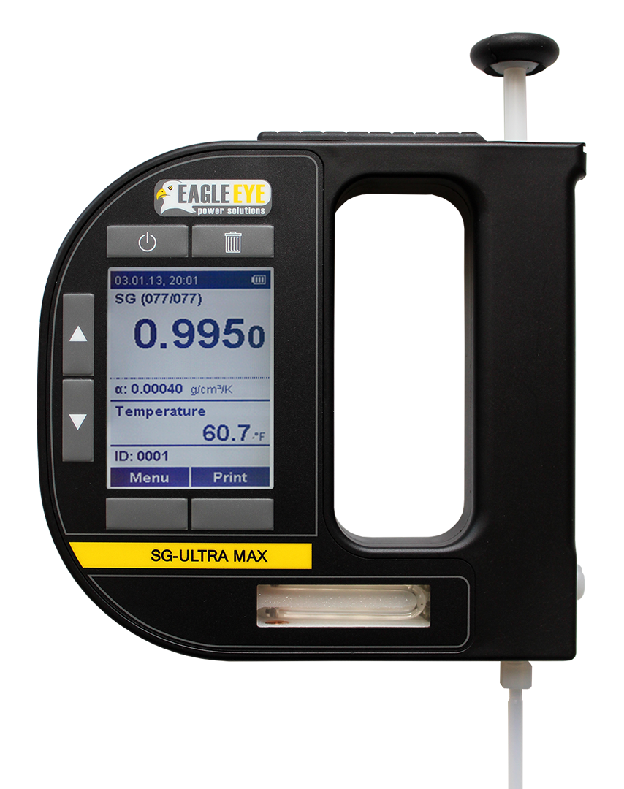
Equipment
Equipment
Electronic Density Meter
These instruments calculate the density and display it on the digital read out
Easy to use
Require only a small amount of product
Easy to clean
Notes:
28

Slide 29
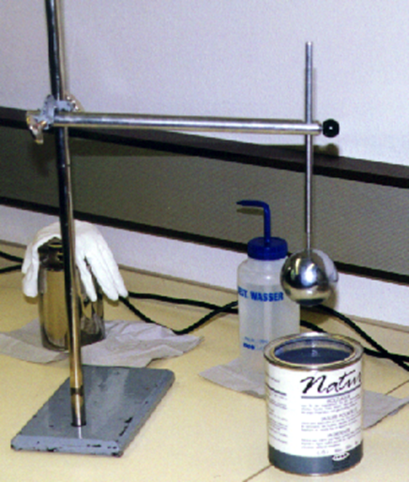
Equipment
Equipment
Displacement Sphere or Plunger
This piece of test equipment comprises of a spherical ball on the end of a rod. There is an annular mark on the rod to indicate the depth of immersion.
The correct volume of the plunger is known. (V)
This device is used to determine the density of paints and lacquers.
Notes:
29

Slide 30
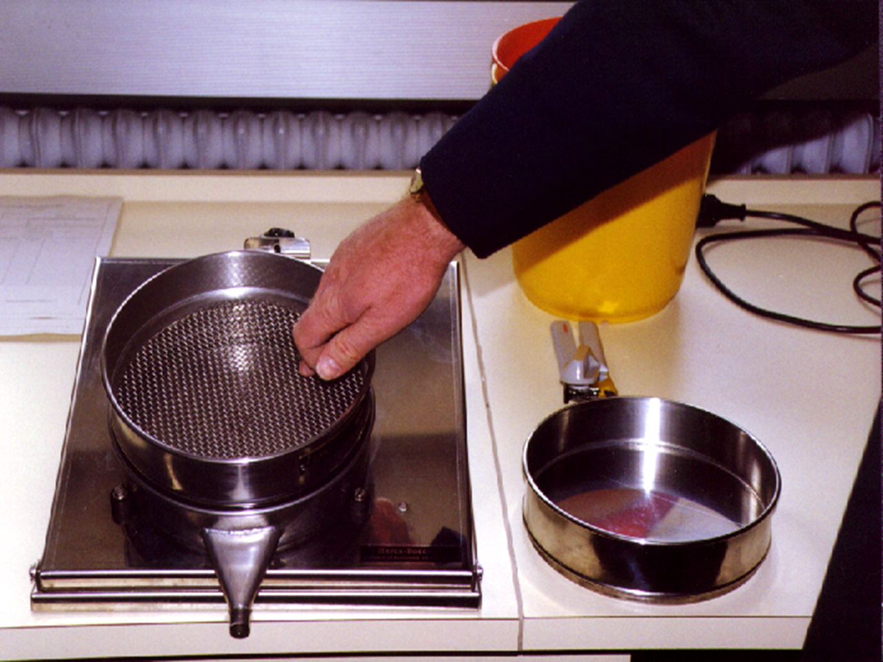
Equipment
Equipment
Sieve & Drip tray
For use in determining the net contents of prepackages with a drained weight, frozen or glazed goods
Notes:
Suitable weighing instrument and test weights.
Sieves
20 cm diameter sieve with 2.5 mm square mesh and a wire thickness of 1.12 mm
for use with pre-packages of 850 mL or less.
30 cm diameter sieve with 2.5 mm square mesh and a wire thickness of 1.12 mm
for use with pre-packages over 850 mL.
Drip pan
Stopwatch.
30

Slide 31
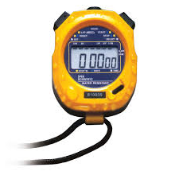
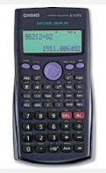
Equipment
Stopwatch
Calculator
Camera?
Suitable Personal Protective Equipment (PPE)
Sample of the packaging material?

Slide 32
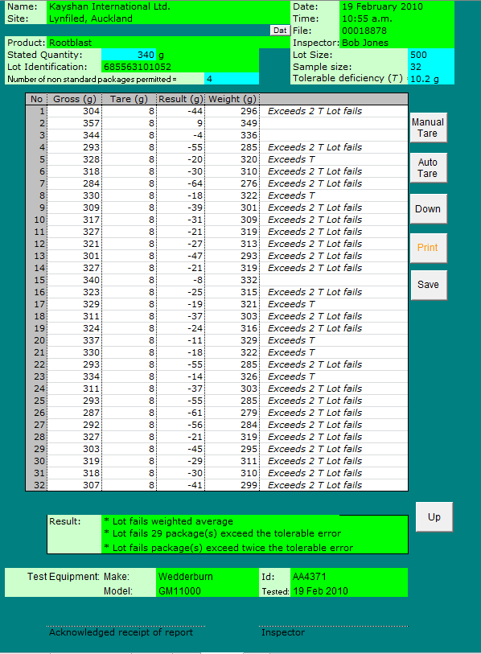
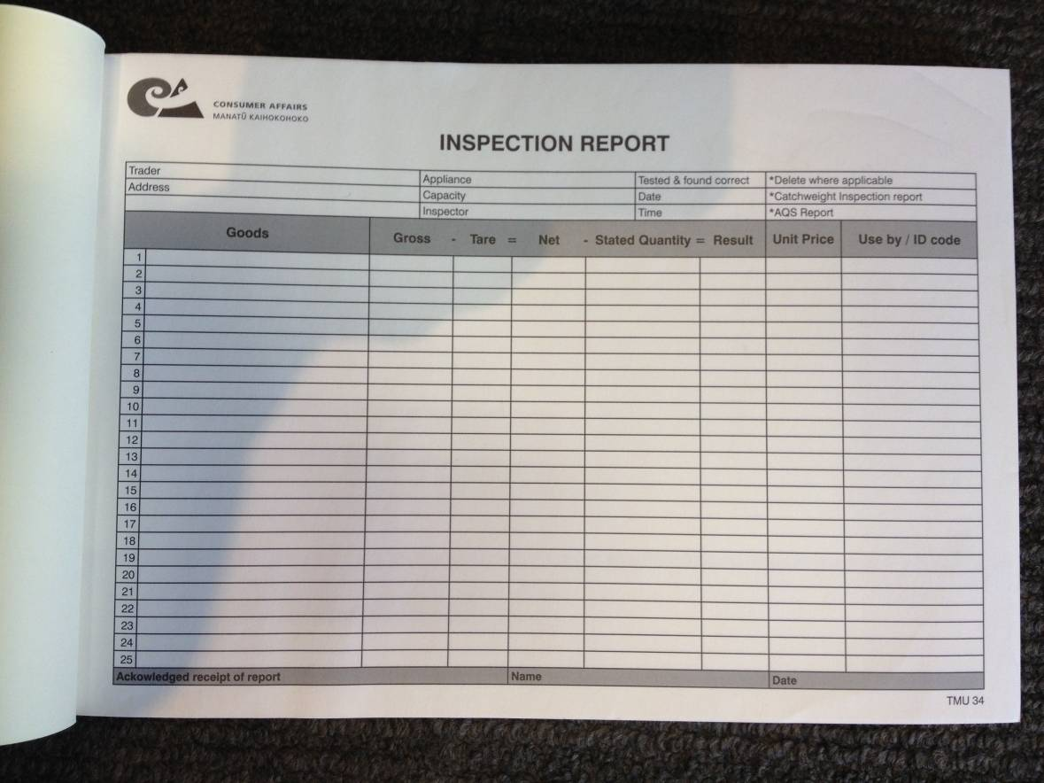
Equipment
Means of recording results from the inspection
Notes:
Demonstration of excel spread sheet

Slide 33
Equipment - Traceability
'traceability' is the...
property of the result of a measurement or the value of a standard whereby it can be related to stated references, usually national or international standards, through an unbroken chain of comparisons all having stated uncertainties.

Slide 34
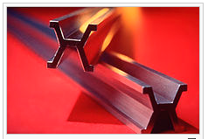
Equipment – Traceability
Traceable to what?
The Metre
Notes:
Many of the measurements we make in legal metrology are traceable to the metre

Slide 35
Equipment – Traceability
Traceable to what?
The Metre is an SI unit
The International System of Units (French: Système International d'Unités, SI) is the modern form of the metric system and is the world's most widely used system of measurement
Notes:
35

Slide 36
Equipment – Traceability
Traceable to what?
Unit name | Unit symbol | Quantity name | Dimension symbol
metre | m | length | L
kilogram | kg | mass | M
second | s | time | T
ampere | A | electric current | I
kelvin | K | thermodynamic temperature | Θ
mole | mol | amount of substance | N
candela | cd | luminous intensity | J
Notes:
SI units
Prepackaged goods are sold by reference to a nominal quantity, usually
-Weight, (mg, g, kg, t)
-Measure, (ml, cl, litre) or
-Number
36

Slide 37
Equipment – Traceability – Metre
The Metre – A very brief history
1791 - French scientists recommend a system based on a unit of length, the metre, equal to one ten-millionth of the distance from the Earth's pole to the equator
Surveyed by Pierre Méchain and Jean-Baptiste Delambre, and took more than six years (1792–98)
Notes:
Six years of work summarised in six seconds…
-Diagram of the earths meridian
Mechain & Delambre surveyed a portion of the quadrant from Dunkirk to Barcelona (about 1000 km, or one-tenth of the total) with start- and end-points at sea level, and that portion was roughly in the middle of the quadrant.
The technical difficulties were not the only problems the surveyors had to face in the convulsed period of the aftermath of the Revolution: Méchain and Delambre, and later Arago, were imprisoned several times during their surveys, and Méchain died in 1804 of yellow fever, which he contracted while trying to improve his original results in northern Spain.

Slide 38
Equipment – Traceability – Metre
The Metre
Basis of definition | Date | Absolute uncertainty | Relative uncertainty
¹⁄_{10,000,000} part of one half of a meridian, measurement by Delambre and Mechain | 1795 | 0.5–0.1 mm | 10⁻⁴
First prototype Metre des Archives platinum bar standard | 1799 | 0.05–0.01 mm | 10⁻⁵
Platinum-iridium bar at melting point of ice (1st CGPM) | 1889 | 0.2–0.1 µm | 10⁻⁷
Platinum-iridium bar at melting point of ice, atmospheric pressure, supported by two rollers (7th CGPM) | 1927 | n.a. | n.a.
1,650,763.73 wavelengths of light from a specified transition in krypton-86 (11th CGPM) | 1960 | 0.01–0.005 µm | 10⁻⁸
Length of the path travelled by light in a vacuum in ¹⁄_{299,792,458} of a second (17th CGPM) | 1983 | 0.1 nm | 10⁻¹⁰
Notes:
The changing definition of the metre
38

Slide 39
Equipment – Traceability – Metre
The Metre
Current Definition of a metre (1983):
The distance travelled by light in vacuum in
1/299,792,458 of a second
Notes:
39

Slide 40
Equipment – Traceability – Kilogram
MASS
1795 - The gram, 1/1000th of a kilogram, was originally defined as the mass of one cubic centimetre of water
1799 - The original prototype kilogram is manufactured
The current kilogram is derived from the original prototype and has a mass equal to the mass of 1.000025 litres of water at 4 °C (the melting point of water)
Notes:
The kilogram or kilogramme (SI unit symbol: kg), is the base unit of mass in the International System of Units (SI) (the Metric system) and is defined as being equal to the mass of the International Prototype of the Kilogram (IPK).
The gram, 1/1000th of a kilogram, was originally defined in 1795 as the mass of one cubic centimeter of water at the melting point of water.[3] The original prototype kilogram, manufactured in 1799 and from which the IPK is derived, had a mass equal to the mass of 1.000025 liters of water at 4 °C

Slide 41
Equipment – Traceability – Kilogram
MASS
The International Prototype Kilogram was commissioned by the General Conference on Weights and Measures (CGPM) under the authority of the Metre Convention (1875), and is in the custody of the International Bureau of Weights and Measures (BIPM) who hold it on behalf of the CGPM.
Notes:
BIPM are based in France
41

Slide 42
Equipment – Traceability – Kilogram
MASS
The value of the kilogram is defined as being equal to the mass of the international prototype of the kilogram.
The kilogram is unique in the SI, being the only unit whose definition is based on a physical artefact.
Notes:
The kilogram is the only SI base unit with an SI prefix ("kilo", symbol "k") as part of its name. It is also the only SI unit that is still directly defined by an artifact rather than a fundamental physical property that can be reproduced in different laboratories. Three other base units in the SI system are defined relative to the kilogram so its stability is important.

Slide 43
Equipment – Traceability – Kilogram
MASS
The International Prototype Kilogram (IPK) is rarely used or handled.
Copies of the IPK kept by national metrology laboratories around the world were compared with the IPK in 1889, 1948, and 1989 to provide traceability of measurements of mass anywhere in the world back to the IPK.
Notes:
43

Slide 44
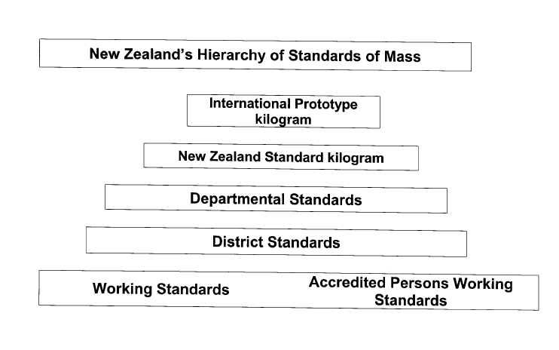
Equipment – Traceability
Unbroken chain of comparisons

Slide 45
Equipment – Traceability
Thank you for your attention
Any Questions?
Notes:
Refrigerated goods,

