Slide 1
Pilot Study on Automated Sphygmomanometers Accuracy Subject Expert for Medical Measurements
Presented by:
Jin-Hai Yang,
Dr. Cheng-Tsair Yang
Bureau of Standards, Metrology and Inspection
Chinese Taipei

Slide 2
Outline
Ⅰ. Initiative
Ⅱ. Project
Ⅲ. Implementation Method
Ⅳ. Relative activity
26th APLMF
Ha Long City, Viet Nam
7-9 November 2019

Slide 3
Initiative-1
The most common methods to measure the blood pressure：
Auscultatory method,
Oscillometric method.
26th APLMF
Ha Long City, Viet Nam
7-9 November 2019

Slide 4
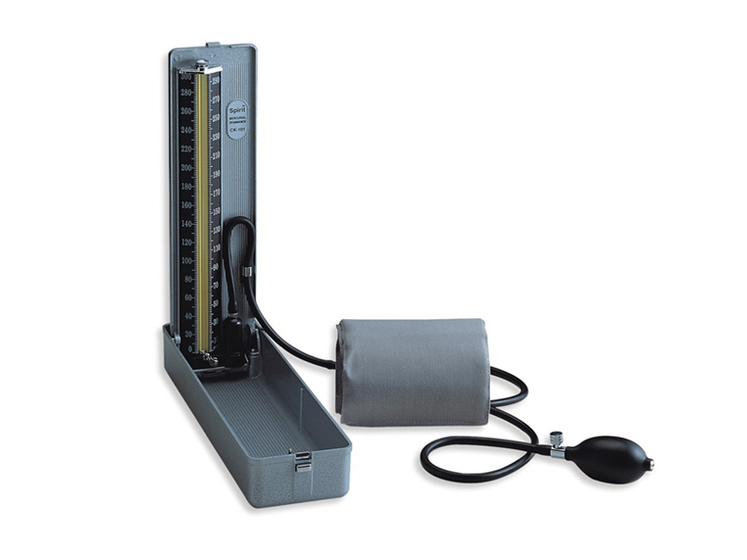
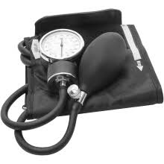
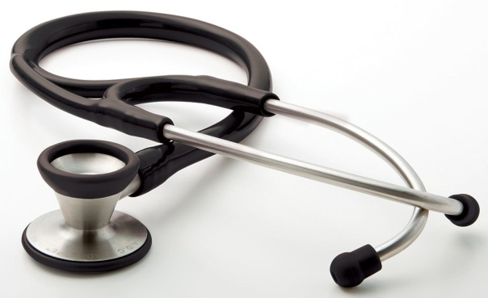
Initiative-2
Auscultatory method and sphygmomanometers applied(OIML R 16-1):
Mercury Column Type
Aneroid Type
26th APLMF
Ha Long City, Viet Nam
7-9 November 2019

Slide 5
Initiative-3
Disadvantage:
Well trained & experienced physician required.
Fatigue.
Fail to identify Korotkoff sounds
26th APLMF
Ha Long City, Viet Nam
7-9 November 2019

Slide 6
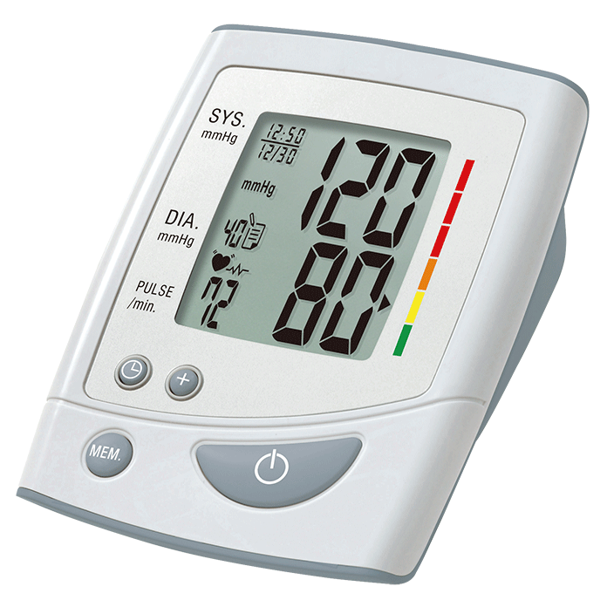
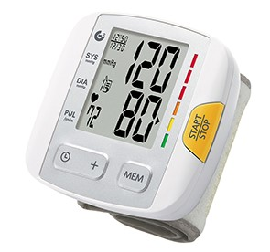
Initiative-4
Oscillometric method and sphygmomanometers applied(OIML R 16-2):
Upper Arm Type
Wrist Type
26th APLMF
Ha Long City, Viet Nam
7-9 November 2019

Slide 7
Initiative-5
Test items of Initial Verification:
the maximum permissible errors of the cuff pressure indication,
the influence of temperature on cuff pressure indication,
the effect of voltage variations of the power source on the cuff pressure indication,
the effect of voltage variations of the power source,
air leakage of the pneumatic system.
26th APLMF
Ha Long City, Viet Nam
7-9 November 2019

Slide 8
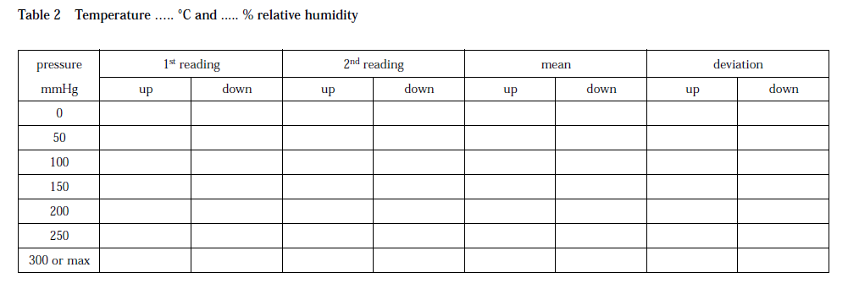
Initiative-6
26th APLMF
Ha Long City, Viet Nam
7-9 November 2019

Slide 9
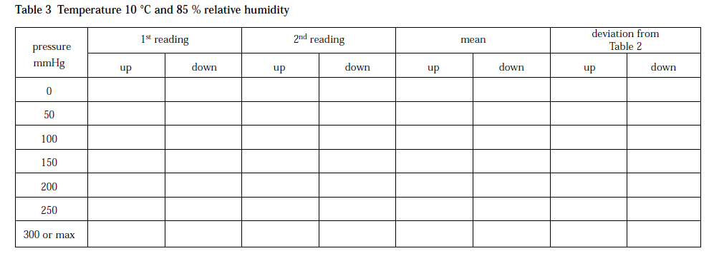
Initiative-7
26th APLMF
Ha Long City, Viet Nam
7-9 November 2019

Slide 10
Project-1
Title: Pilot Study on Automated Sphygmomanometer Accuracy Test Using Blood Pressure Simulation Technique/APMP MMFG INITIATIVE PROJECT
Duration: June 01, 2018~December 31,2019
Participate Economies:
P.R. China,
Rep. Korea,
Chinese Taipei.
26th APLMF
Ha Long City, Viet Nam
7-9 November 2019

Slide 11
Project-2
The main purpose:
to establish an ISO/IEC 81060 compliant method for evaluating/testing the accuracy of automated sphygmomanometers using real human blood pressure (BP) simulation technique,
to develop an APMP regional guideline for accuracy test of automated sphygmomanometers using blood pressure simulation system.
26th APLMF
Ha Long City, Viet Nam
7-9 November 2019

Slide 12
Project-3
Kick off meeting
Held at KRISS on 6-7 September 2018,
Six delegates attended:
Dr. Sheng-Jui Chen from CMS/ITRI,
Dr. Yong-Tae Kim and Dr. Il Doh from KRISS,
Dr. Ding Xiang and Dr. Hu Zhixiong from NIM,
Dr. Ashok Kumar from CSIR-NPL.
Introduction of each NMI’s BP simulation development,
Discussion on the draft protocol for BP simulation pilot study:
Standardize the waveform format,
Exchange waveforms for comparison,
Verify the feasibility of BP accuracy evaluation using NIBP simulator.
26th APLMF
Ha Long City, Viet Nam
7-9 November 2019

Slide 13
Project-4
2nd MMFG FGI Project Workshop
Held at NIM on 9-12 September 2019,
Participating Economies:
India, Philippines, P.R. China, Rep. Korea, Chinese Taipei.
Progress report of FGI:
Protocol of Pilot Study on Automated Sphygmomanometer Accuracy Test by Using Blood Pressure Simulation Technique_v3,
Results of BP simulation pilot study.
Discussion on related topics:
BP clinical data collection demonstration,
Continuous non-invasive sphygmomanometers .
26th APLMF
Ha Long City, Viet Nam
7-9 November 2019

Slide 14
Project-5
Protocol of the pilot study
Measurement procedure,
Part I: characterize the basic capabilities of the participant’s blood pressure simulation system:
Accuracy of the static pressure,
Accuracy of the pulse rate,
Repeatability of the oscillation amplitude,
Repeatability of the oscillation shape.
Part II: accuracy test of two commercial NIBP oscillometric devices.
26th APLMF
Ha Long City, Viet Nam
7-9 November 2019

Slide 15
Implementation Method-1
International standards:
(i) ISO 81060-2:2018 Non-invasive sphygmomanometers --Part 2: Clinical investigation of automated measurement type,
(ii) EN 1060-4:2004 Non-invasive sphygmomanometers. Test procedures to determine the overall system accuracy of automated non-invasive sphygmomanometers.
26th APLMF
Ha Long City, Viet Nam
7-9 November 2019

Slide 16
Implementation Method-2
Participants produce BP waveform data by their own blood pressure simulation system (BPSS) to check:
(i) the data compatibility with the BPSS,
(ii) consistency between original and regenerated BP waveforms (this will reference a new draft ISO standard),
(iii) the correctness of systolic and diastolic BP values regenerated by the BPSS.
26th APLMF
Ha Long City, Viet Nam
7-9 November 2019

Slide 17
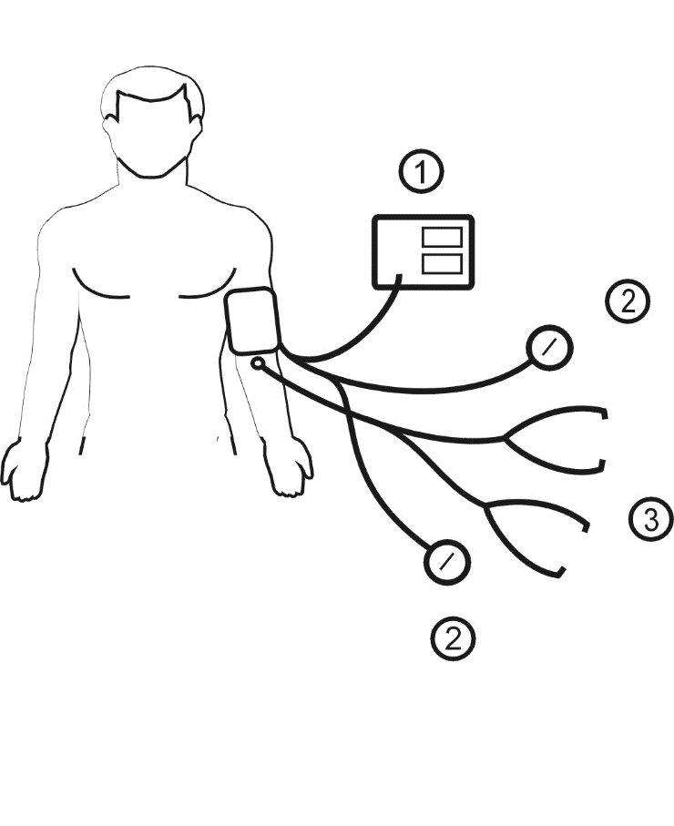
Implementation Method-3
Comparison with an auscultatory reference sphygmomanometer(Same arm simultaneously method):
1.Tested device( simulator),
2.Reference manometers,
3.Double stethoscopes.
26th APLMF
Ha Long City, Viet Nam
7-9 November 2019

Slide 18
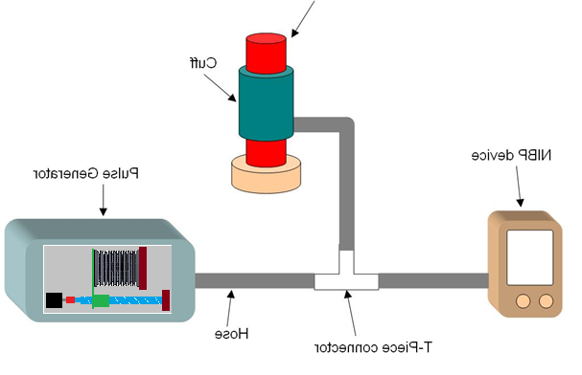
Implementation Method-4
CMS/ITRI’s Human BP simulator
The simulator is programmed to produce small oscillometric pulses according to the extracted oscillometric pulses and the instantaneous pressure inside the cuff.
Mandrel
Cuff
NIBP Device
Pulse Generator
Hose
T-Piece connector
26th APLMF
Ha Long City, Viet Nam
7-9 November 2019

Slide 19
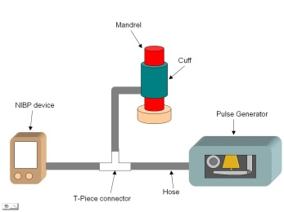
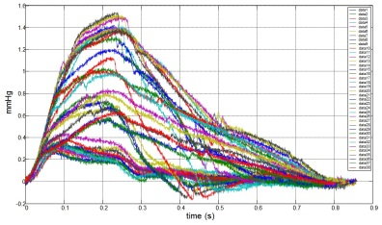
Implementation Method-5
Original idea for the Pilot Study
Reference BP waveform BP Simulators Results
database
Systolic & diastolic pressures
CMS/ITRI BP Waveforms
CMS/ITRI BP Simulator
Systolic & diastolic pressures
KRISS BP Waveforms
KRISS BP Waveforms
26th APLMF
Ha Long City, Viet Nam
7-9 November 2019

Slide 20
Relative Activity-1
APLMF MEDEA 2.0 in medical metrology field
Title: Training Course on Calibration & Testing on Non-Invasive Sphygmomanometers,
Duration: November 11~15, 2019.
Objective: To improve the metrological traceability of non- invasive sphygmomanometer and the legal metrological control of the device after the market.
This training course was requested by participant during the MEDEA 2.0 workshop on July 3-6 2018 in Hong Kong.
26th APLMF
Ha Long City, Viet Nam
7-9 November 2019

Slide 21
Relative Activity-2
Achievement: To provide developing economies’ metrological staff:
to have basic knowledge of legal metrology, medical metrology and blood pressure measurement technique,
to establish the fundamental background of the global regulations of non-invasive sphygmomanometer,
to establish the technology of how to calibration and testing non-invasive sphygmomanometer,
to understand the linkage between scientific metrology and legal metrology of non-invasive sphygmomanometer.
26th APLMF
Ha Long City, Viet Nam
7-9 November 2019

Slide 22
Relative Activity-3
Host: National Metrology Institute of Malaysia.
Venue: Concorde Hotel Shah, Kuala Lumpur,
Trainer:
Dr. Stephan Mieke (PTB retire, ISO expert),
Mr. Chen Chuan Hung (CMS/ITRI), Co-Trainer: Mr Mazid Mansur (NMIM).
26th APLMF
Ha Long City, Viet Nam
7-9 November 2019

Slide 23
The end
Thanks for your attention!
26th APLMF
Ha Long City, Viet Nam
7-9 November 2019

