Slide 1
PRE-PACKAGED PRODUCTS SAMPLING
Ben Aitken
Trading Standards Officer
Trading Standards
MBIE
New Zealand
Kevin Gudmundsson
Legal Metrology Advisor
Trading Standards
MBIE
New Zealand

Slide 2
Sampling
Sampling is the act of randomly selecting a sample of pre-packages from an inspection lot (or batch) to determine the conformance of that inspection lot.
An inspection lot taken from the production line shall consist of all prepackages not rejected by a checking system

Slide 3
Sample
Care shall be taken to prevent other than normal operating adjustments or other corrective actions in the production and prepackage filling process.
Sample prepackages must be collected after the point of final checking by the packer.

Slide 4
Sampling
Why do we sample?
To save time
Requires less resources
Practical reasons
When done correctly we can draw accurate conclusions
Fairer representation of the packing process
Notes:
To provide a random selection of packages across the production batch. Provides a fairer inspection for the manufacturer and a greater insight into the packing process for the LMO

Slide 5
Sampling
Metrological requirements for a pre-package must be met at each point in the supply chain
A sample may be selected from;
The Point of Pack, import, distribution & wholesale transactions, and sale (e.g. where a package is offered or exposed for sale or sold).

Slide 6
Sample
Inspection Lot (also called a batch)
Definite quantity of pre-packages produced at one time under conditions that are presumed to be uniform and from which a sample is drawn and inspected to determine conformance with specified criteria for acceptance or rejection of the inspection lot as a whole

Slide 7
Sampling
Inspection lots are assumed to be uniform
Random sampling techniques are used
Sample selection after final point of checking by packer

Slide 8
Sampling
Sample Size (n)
See column 2 Table 1
Pre-packages taken from an inspection lot.
Provides information for the decision to accept or reject the inspection lot
Notes:
Prepackages taken from an inspection lot and used to provide information that will serve as the basis for a decision on the conformance of the inspection lot.
Note: The symbol ‘n’ means sample size.

Slide 9
Sampling
R87 - Table 1 Sampling plans for pre-packages

Slide 10
Sampling
Sampling from
Production the line at the packers premises
Not from the production line at the packer’s premises
At any other point in the distribution chain
Notes:
The tests may be performed in accordance with quality acceptance inspection by sampling prepackages at any level of distribution including at the point-of pack, import, distribution and wholesale transactions, and sale.

Slide 11
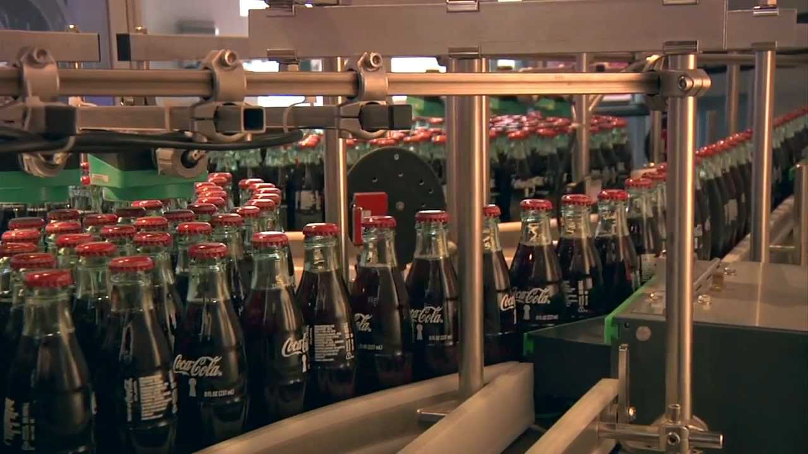
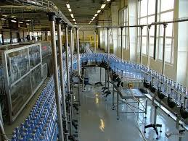
Sampling
1. Production line

Slide 12
Sampling
Sample pre-packages chosen from the production line
inspection lot size = maximum hourly
output of production line
There is no restriction on the size of the inspection lot.
Notes:
When sample prepackages are:
i) Collected from the production line: the size of the inspection lot shall be equal to the maximum hourly output of the production line without any restriction as to the inspection lot size

Slide 13
Sampling
Example: Production line producing 4500 prepackages per hour
R87 - Table 1 Sampling plans for pre-packages

Slide 14
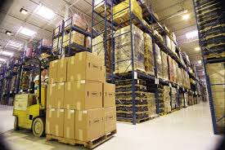
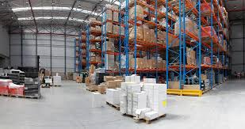
Sampling
2. Not from the production line at the packer’s premises

Slide 15
Sampling
Sample pre-packages chosen not from the production line at the packer’s premises
There are two scenarios
Line output >10,000 packages / hour
Line output <10,000 packages / hour
Notes:
Need to determine the line output in order to establish the sample size from Table 1.

Slide 16
Sampling
If the production line output exceeds
10 000 pre-packages per hour;
Inspection lot size = Maximum Hourly Output
of Production Line
There is no restriction on the size of the inspection lot.
Notes:
Not collected from the production line at the premises of the packer, and when:
• The production line output exceeds 10 000 prepackages per hour: the size of the inspection lot shall be equal to the maximum hourly output of the production line without any restriction as to the inspection lot size

Slide 17
Sampling
2. If the production line output is 10 000 or fewer pre-packages per hour:
The inspection lot size shall not exceed 10 000 pre-packages.
Notes:
Not collected from the production line at the premises of the packer, and when:
• The production line output is 10 000 or fewer prepackages per hour: the inspection lot size
shall not exceed 10 000 prepackages

Slide 18
Sampling
Scenario One
Sample chosen at the premises of the packer but not taken from the production line.
Line output maximum = 12000 prepackages per hour
Notes:
Not collected from the production line at the premises of the packer

Slide 19
Sampling
The production line output exceeds
10 000 prepackages per hour;
Inspection lot size = Maximum Hourly Output
of Production Line
There is no restriction on the size of the inspection lot.
Notes:
Not collected from the production line at the premises of the packer, and when:
• The production line output exceeds 10 000 prepackages per hour: the size of the inspection lot shall be equal to the maximum hourly output of the production line without any restriction as to the inspection lot size

Slide 20
Sampling
Scenario 1: Line output 12000 prepackages per hour
R87 - Table 1 Sampling plans for pre-packages

Slide 21
Sampling
Scenario Two
Sample chosen at the premises of the packer but not taken from the production line.
Line output maximum = 6500 prepackages per hour
Notes:
Sample collected at the premises of the packer but not from the production line, and when:
• The production line output is 10 000 or fewer prepackages per hour: the inspection lot size
shall not exceed 10 000 prepackages

Slide 22
Sampling
2. The production line output is 10 000 or fewer pre-packages per hour:
The inspection lot size shall not exceed 10 000 pre-packages.
Notes:
Not collected from the production line at the premises of the packer, and when:
• The production line output is 10 000 or fewer prepackages per hour: the inspection lot size
shall not exceed 10 000 prepackages

Slide 23
Sampling
Scenario 2: Line output 6500 prepackages per hour
R87 - Table 1 Sampling plans for pre-packages

Slide 24
Sampling
Thank you for your attention
Any Questions?

