Slide 1
PRE-PACKAGED PRODUCTS HYGROSCOPIC & DESICCATING GOODS
Ben Aitken
Trading Standards Officer
Trading Standards
MBIE
New Zealand
Kevin Gudmundsson
Legal Metrology Advisor
Trading Standards
MBIE
New Zealand

Slide 2
Hygroscopic Goods
LMO’s may permit deviations in the quantity of product (i.e. hygroscopic products) caused by ordinary and customary exposure to environmental conditions that occur in storage and distribution in the evaluation of both the average and individual prepackage requirements
Notes:
Hygroscopic Products - attract and hold water molecules from the environment –fertilizers, soap flakes, yeast

Slide 3
Desiccating Goods
Case Study

Slide 4
Desiccating Goods
NZ Specific Requirements
Desiccating goods are goods made up in a package that lose weight or volume solely through evaporation after the package is made up.
Not to be confused with hygroscopic goods that both hydrate and dehydrate with climatic conditions.

Slide 5
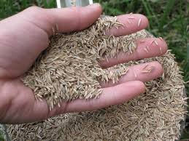
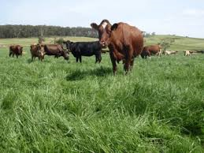
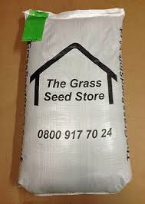
Desiccating Goods
Grass Seed

Slide 6
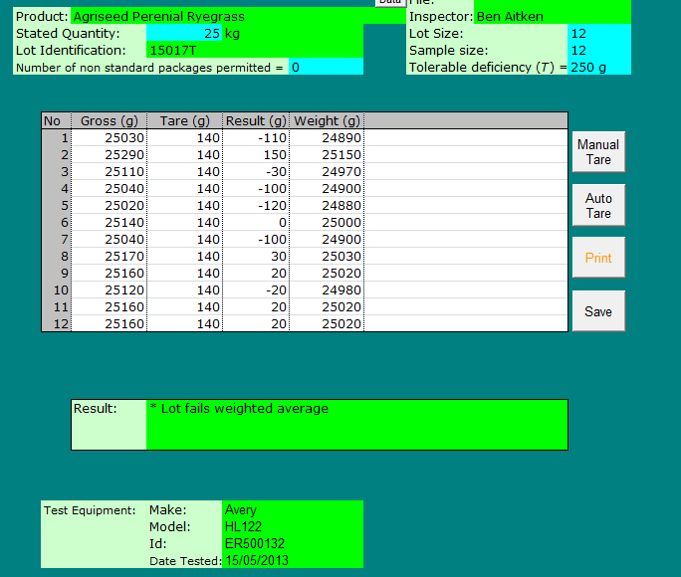
Desiccating Goods
Marketplace surveillance revealed concerns with 25kg bags of perennial ryegrass seed

Slide 7
Desiccating Goods
Investigation leads to an AQS reference test at the packers premises
First sample fails AQS reference test – batch packaged 10 months earlier
Second sample, packaged one month prior, passes AQS reference test.

Slide 8
Desiccating Goods
The ryegrass seed had an endophyte living on it
The pre-packages needed to be stored at temperature of 10 degrees Celsius
They were stored in a refrigerated warehouse with very low ambient humidity

Slide 9
Desiccating Goods
Some economies have a defence for goods which are deemed to be desiccating
New Zealand weights and measures legislation offers two defences for desiccating goods

Slide 10
Desiccating Goods
New Zealand defences for desiccating goods
At all times during the ‘Required Period’ the goods meet the requirements of AQS
At any time after the close of the required period, a sample taken from the lot contains no inadequate packages

Slide 11
Desiccating Goods
In this instance Trading Standards applied an educational approach which led to the development of resources to encourage compliance

Slide 12
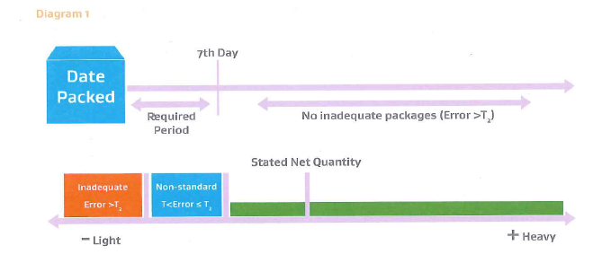
Desiccating Goods

Slide 13
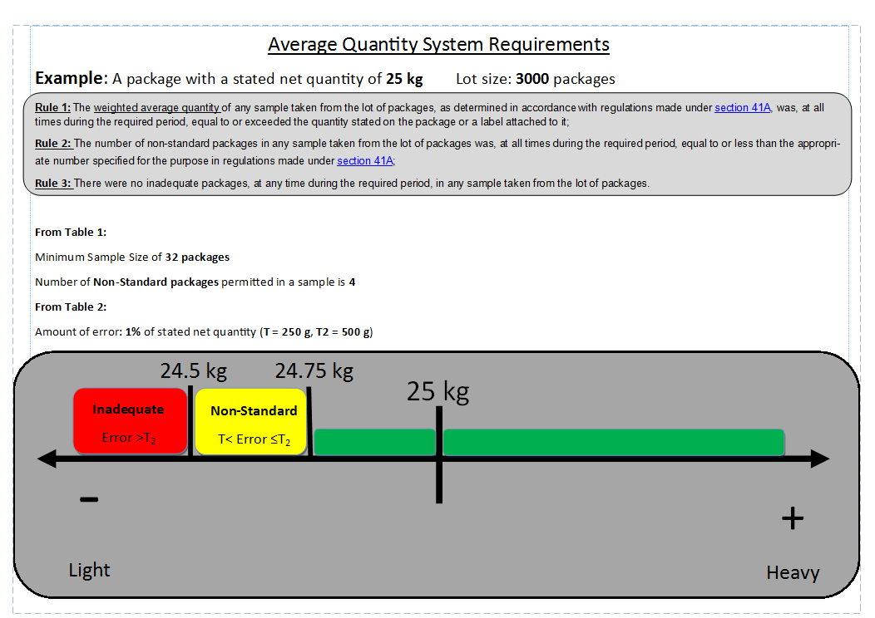
Desiccating Goods

Slide 14
Desiccating Goods

