Slide 1
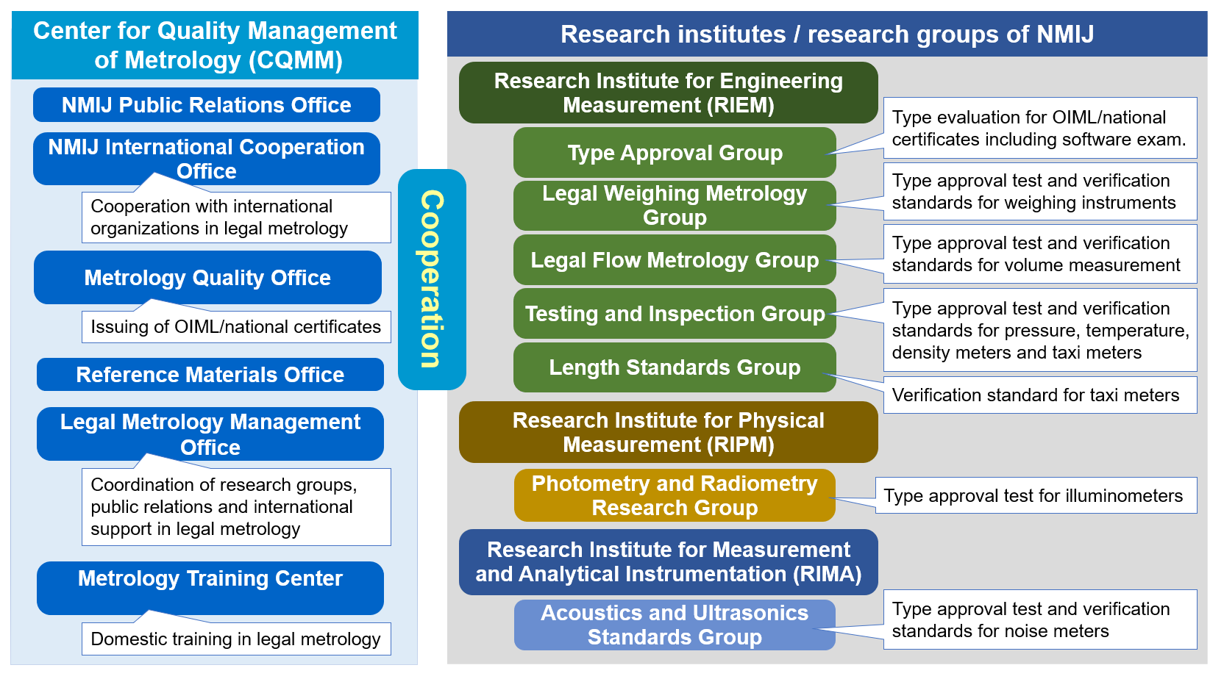
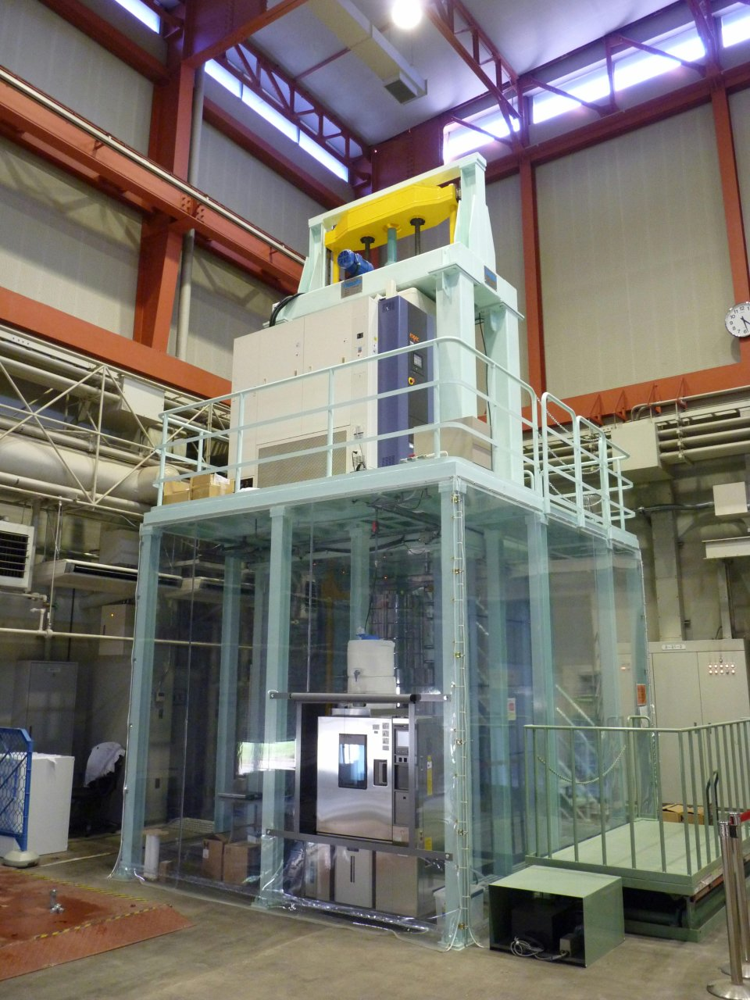
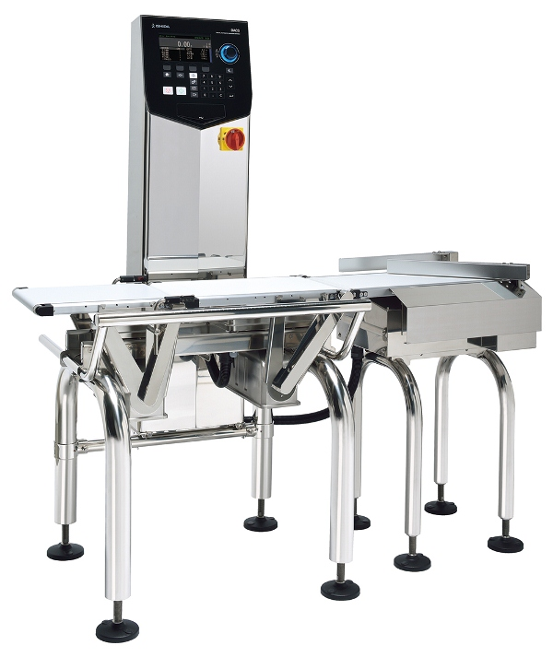
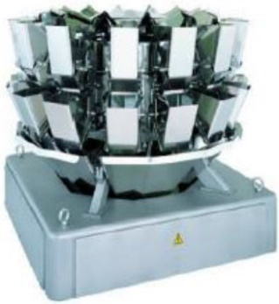
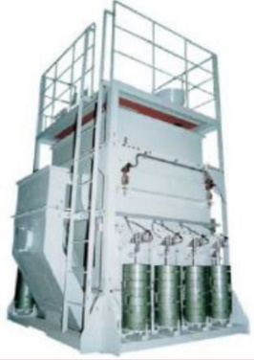
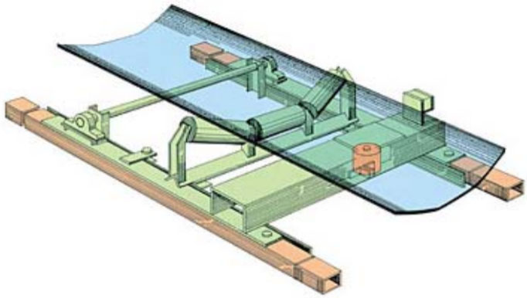
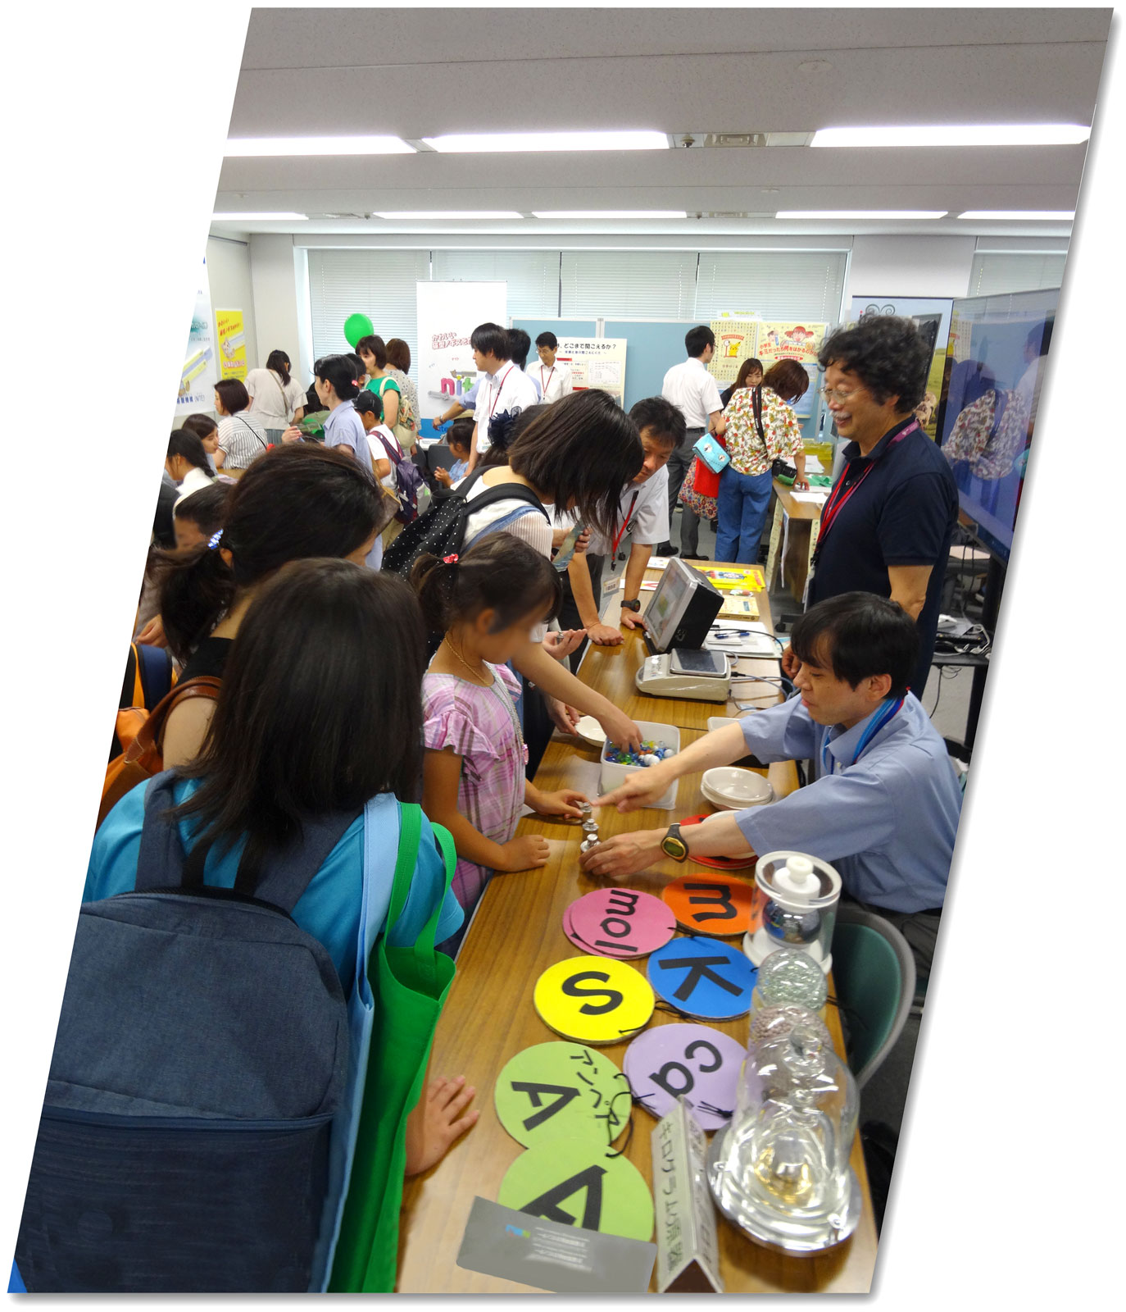
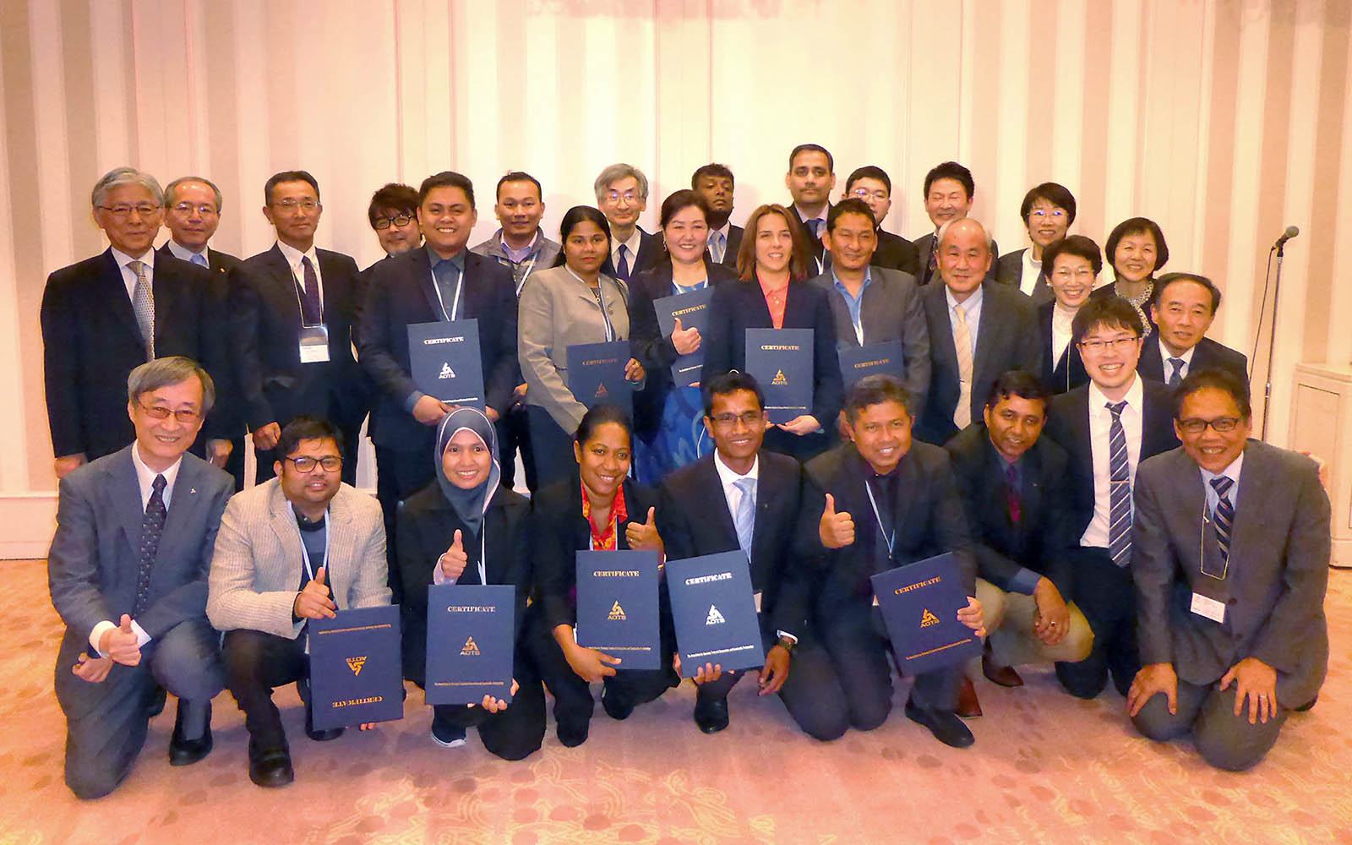
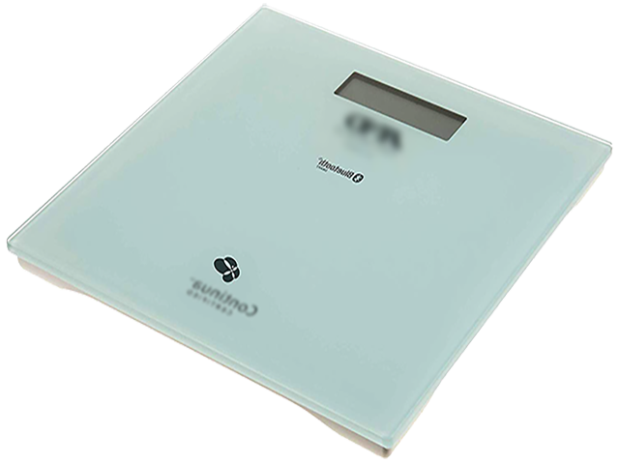
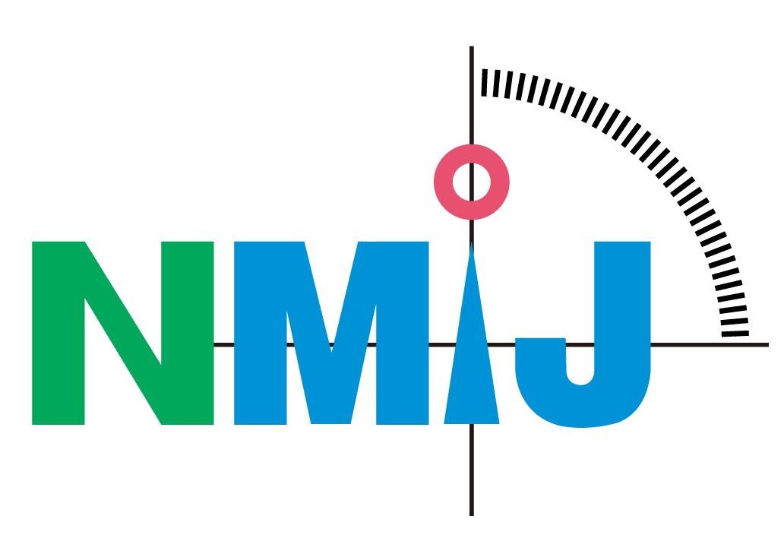
Japan - Economy Report Highlights
Key Activities - 2018 / 2019
Reformation of Legal Metrology System
Cabinet orders and ministerial ordinances under Measurement Act were revised.
Utilization of Designated Verification Institutes (DVI) was approved for verifying NAWIs (non-automatic weighing instruments), AWIs (automatic weighing instruments) and fuel dispensers. DVIs (mostly private organizations) need to pass an assessment by METI and their staff should attend a training course in NMIJ.
Introduction of a new legal metrological control system on AWIs (OIML R 50, R 51, R 61 & R 107) is in progress until 2026. Technical requirements are specified in JISs (Japan Industrial Standards). Type approval (by NMIJ) and verification (by DVIs) on R 51 started in Apr. 2019.
NMIJ’s Cooperation with OIML and APLMF
Supported the project on OIML R 139 (compressed gaseous fuels measuring systems for vehicles) to include hydrogen dispensers. New R 139 was published in 2018.
Cooperates with OIML-CS and issues certificates for R 60 and R 76 in scheme A.
Revises R 63 (petroleum tables) and R 119 (pipe provers) as TC 8 Secretariat.
In APLMF, NMIJ provides an EC member and supports WG on QMAP (Quality Measurement of Agricultural Products).
Automatic catch weighing instrument (R 51)
Continuous totalizing automatic weighing instruments (R 50)
Automatic gravimetric filling instruments (R 61)
Discontinuous totalizing automatic weighing instruments (R 107)
NMIJ’s structure for legal metrology
Testing machine for load cells (20 t)
AOTS Training Course
A training course in legal and scientific metrology was conducted by METI, NMIJ and AOTS (Association for Overseas Technical Cooperation and Sustainable Partnerships) in Dec. 2018 in Tokyo with the 14 participants.
Promotional and Awareness Raising Events
Metrology Day on 1st November by METI
Children’s Day on 7-8th Aug. by METI (photo)
Post-Market Surveillance on Measuring Instruments
METI & NMIJ conduct an annual post-market surveillance with trial purchase on measuring instruments since 2013. Measuring instruments are purchased at the market without a notice to the manufacturer, and their performances are tested by NMIJ.
In FY2017, a total of 50 types of NAWIs, bathroom scales and kitchen scales were tested. The results, including non-conformances, were reported on the METI’s website (in Japanese).
Presenters – Mikuko Hamada, Toshiyuki Takatsuji, Hajime Nemoto and Tsuyoshi Matsumoto

